Slide 1


































Microsoft Azure Data Analytics Platform アーキテクチャ
Generate
Ingest
Store
Process
Enrich
Serve
Consume
On-Prems / Cloud
Realtime
Stream
Hot Path
IoT Hub
Batch
Functions
Power BI Premium
Dashboard
Event Hubs
Stream Analytics
Unstructured Semi Structured
Cognitive Services
Analytics
SQL Database
Relational
Dedicated SQL
Data Explorer
Machine Learning
Cold Path
Dataflow
Cosmos DB
Data-driven Applications
Pipeline
NoSQL
Serverless Spark
Serverless SQL
HTAP with Synapse Link
Data Lake
Data Share
Shared Datasets
Discover & Govern
Azure Purview
Azure Active Directory
Azure Cost Management
Azure Key Vault
Azure Security Center
Platform
Azure Monitor
Azure DevOps
GitHub
Azure Policy

Slide 2
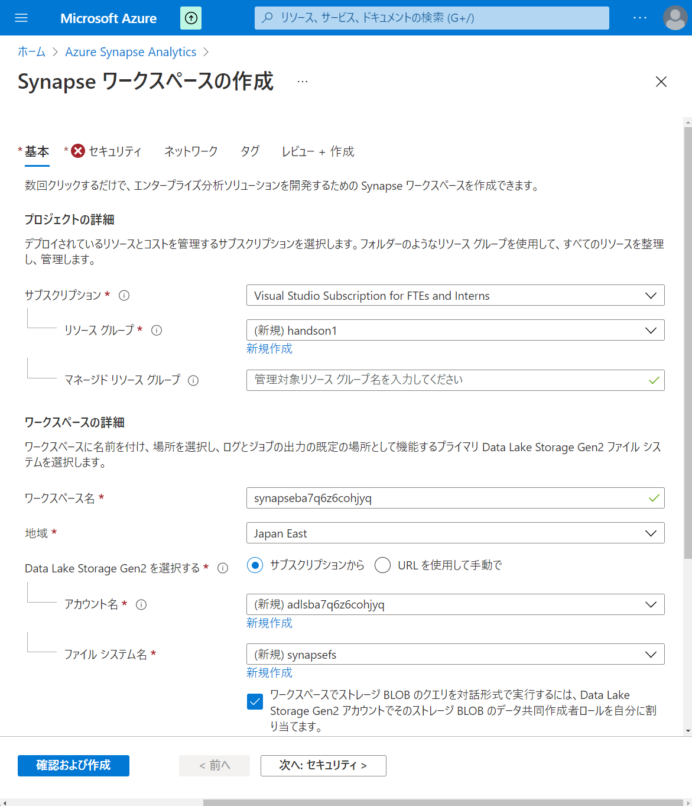

Slide 3
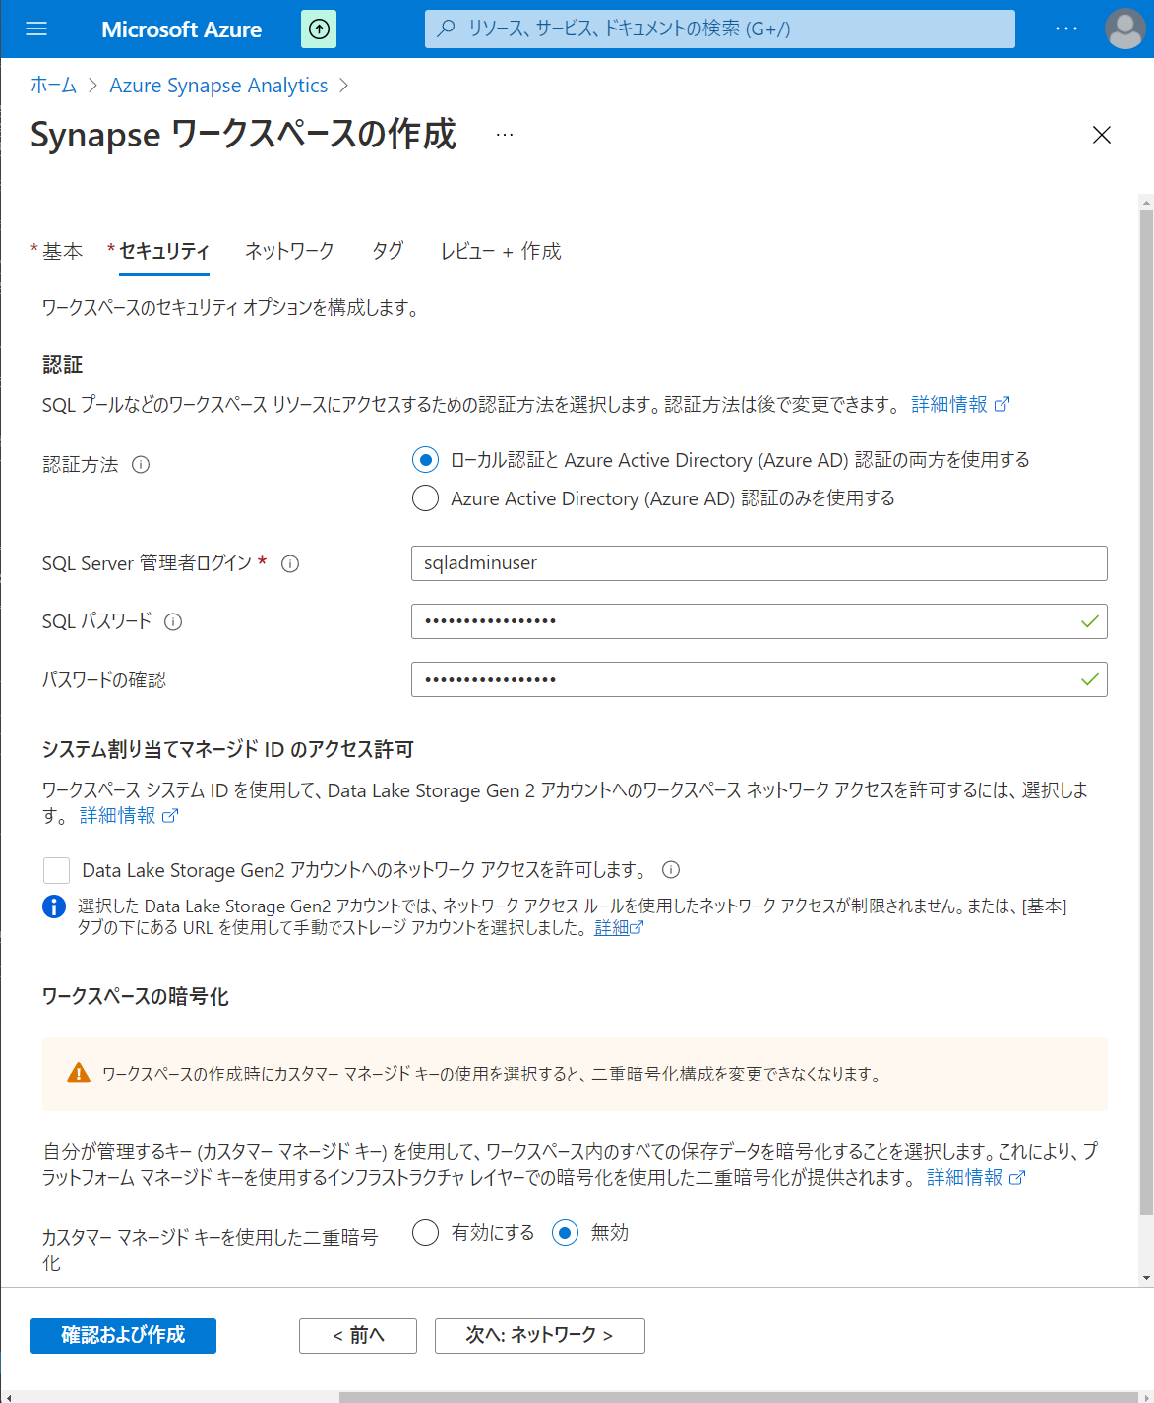

Slide 4
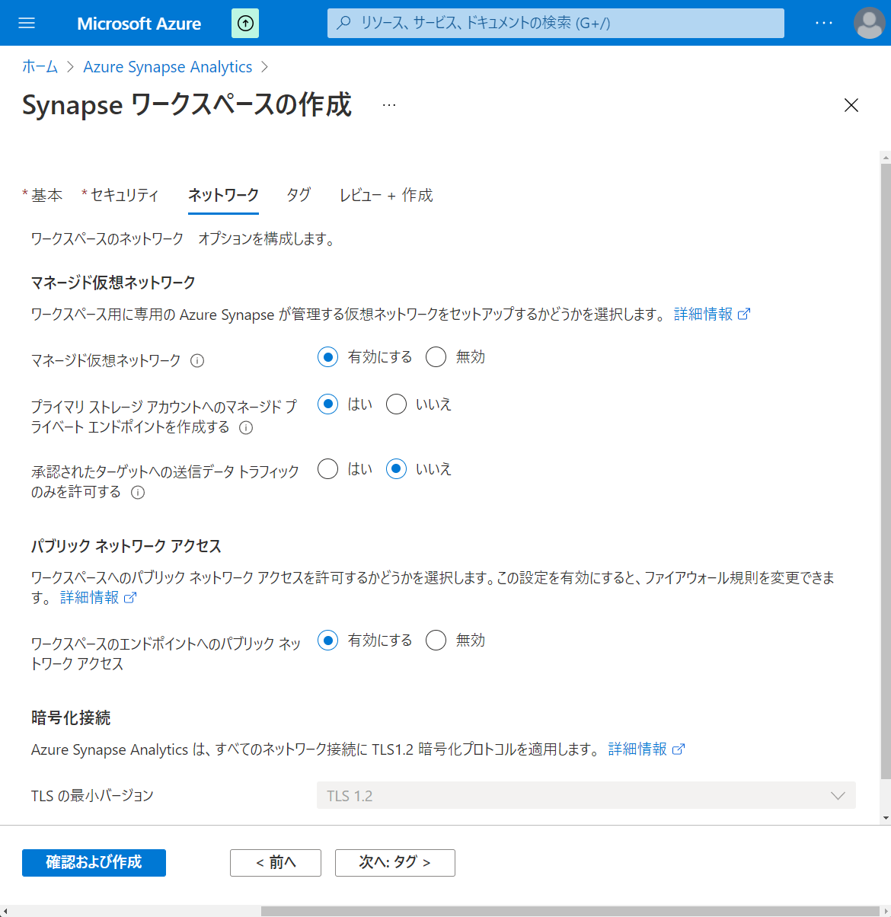

Slide 5
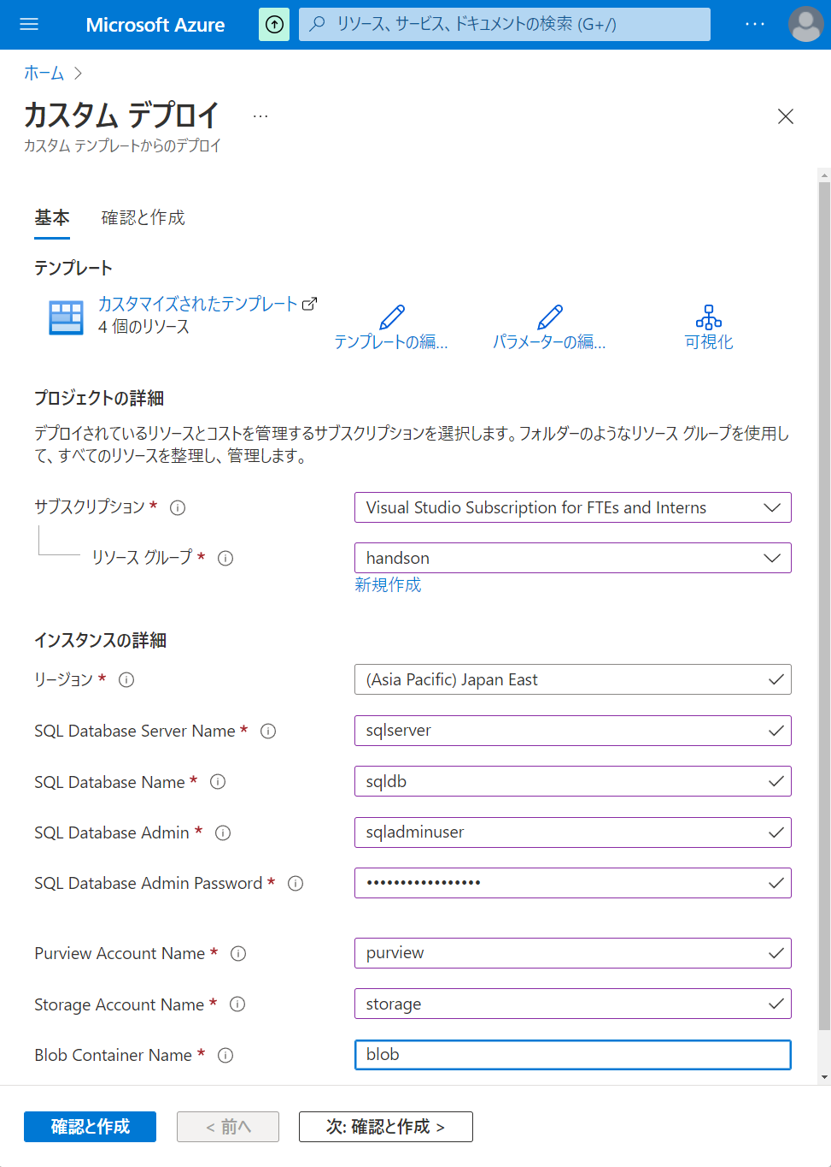

Slide 6
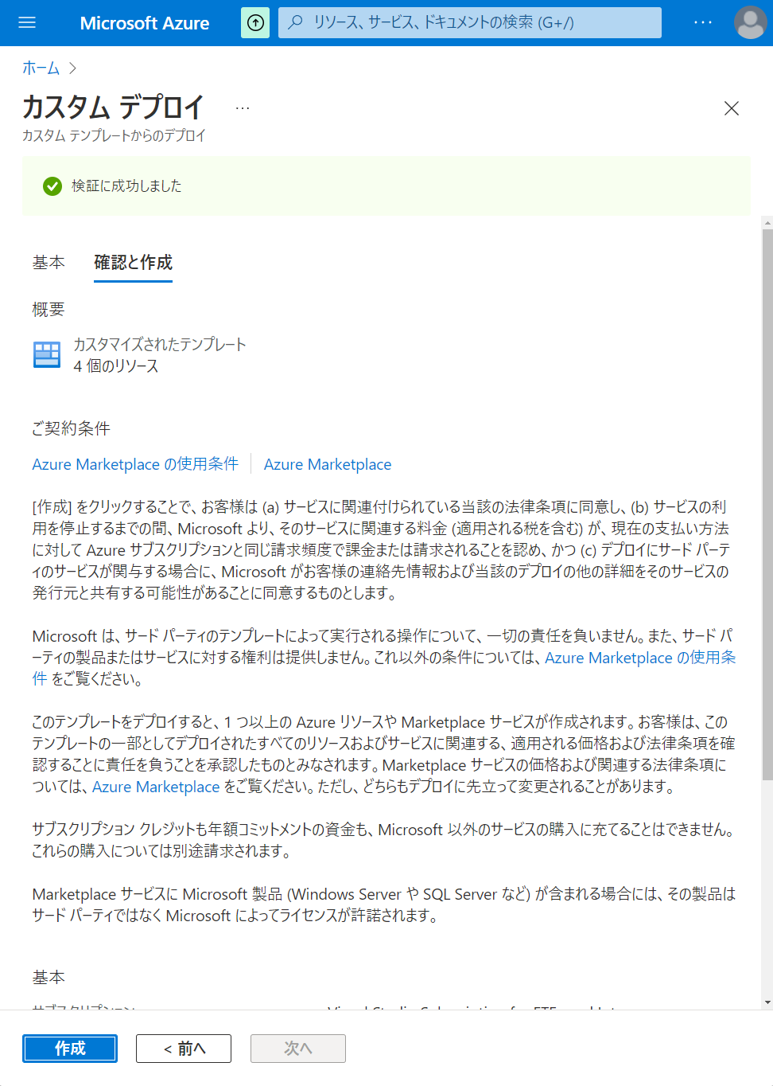

Slide 7
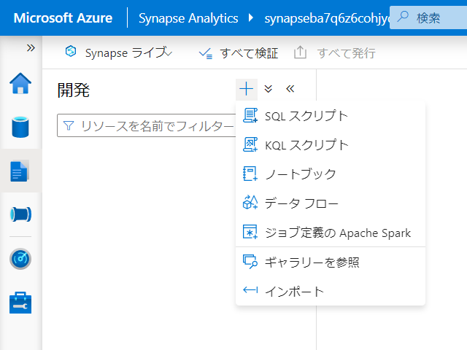

Slide 8
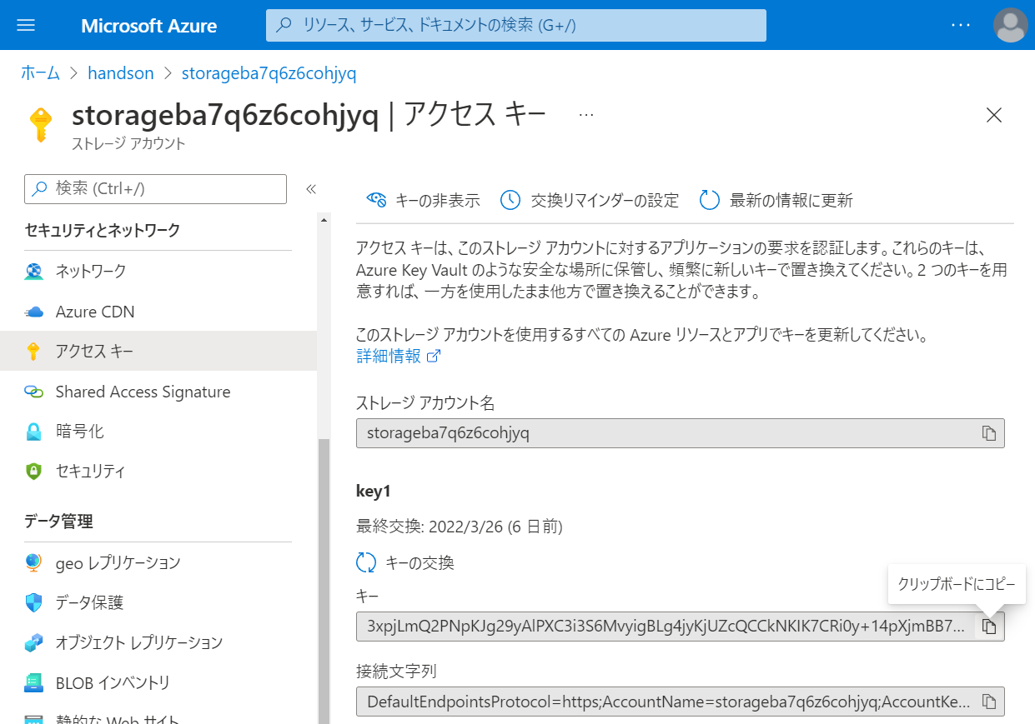

Slide 9
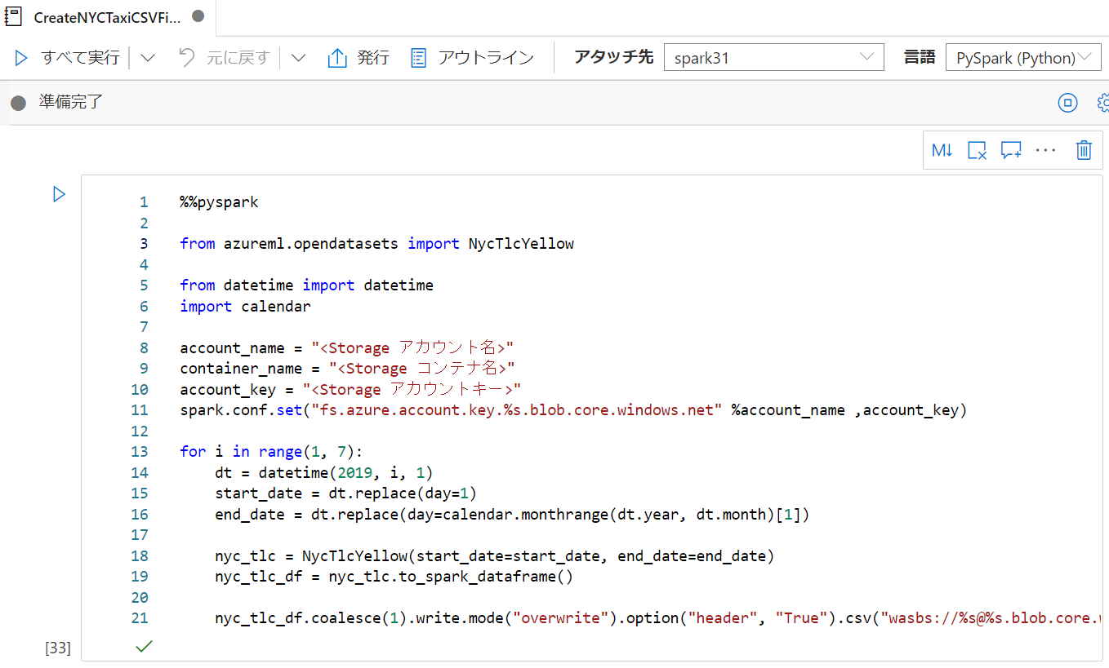

Slide 10
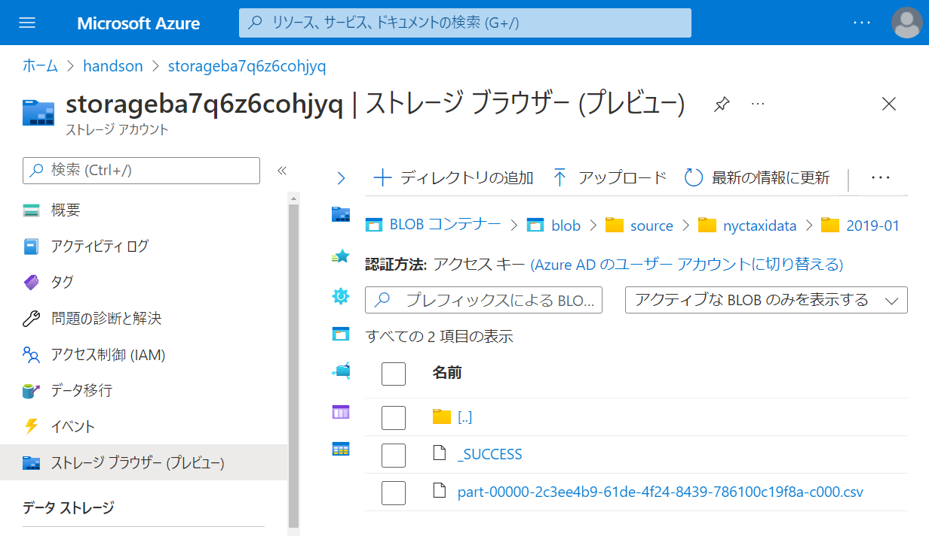

Slide 11
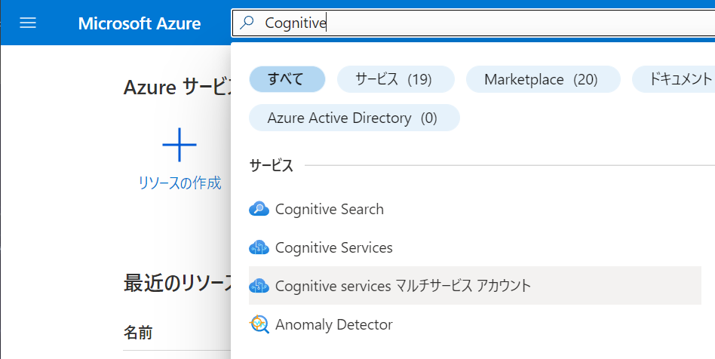

Slide 12
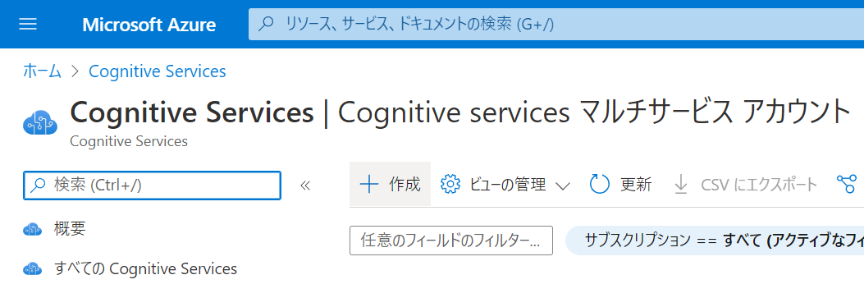

Slide 13
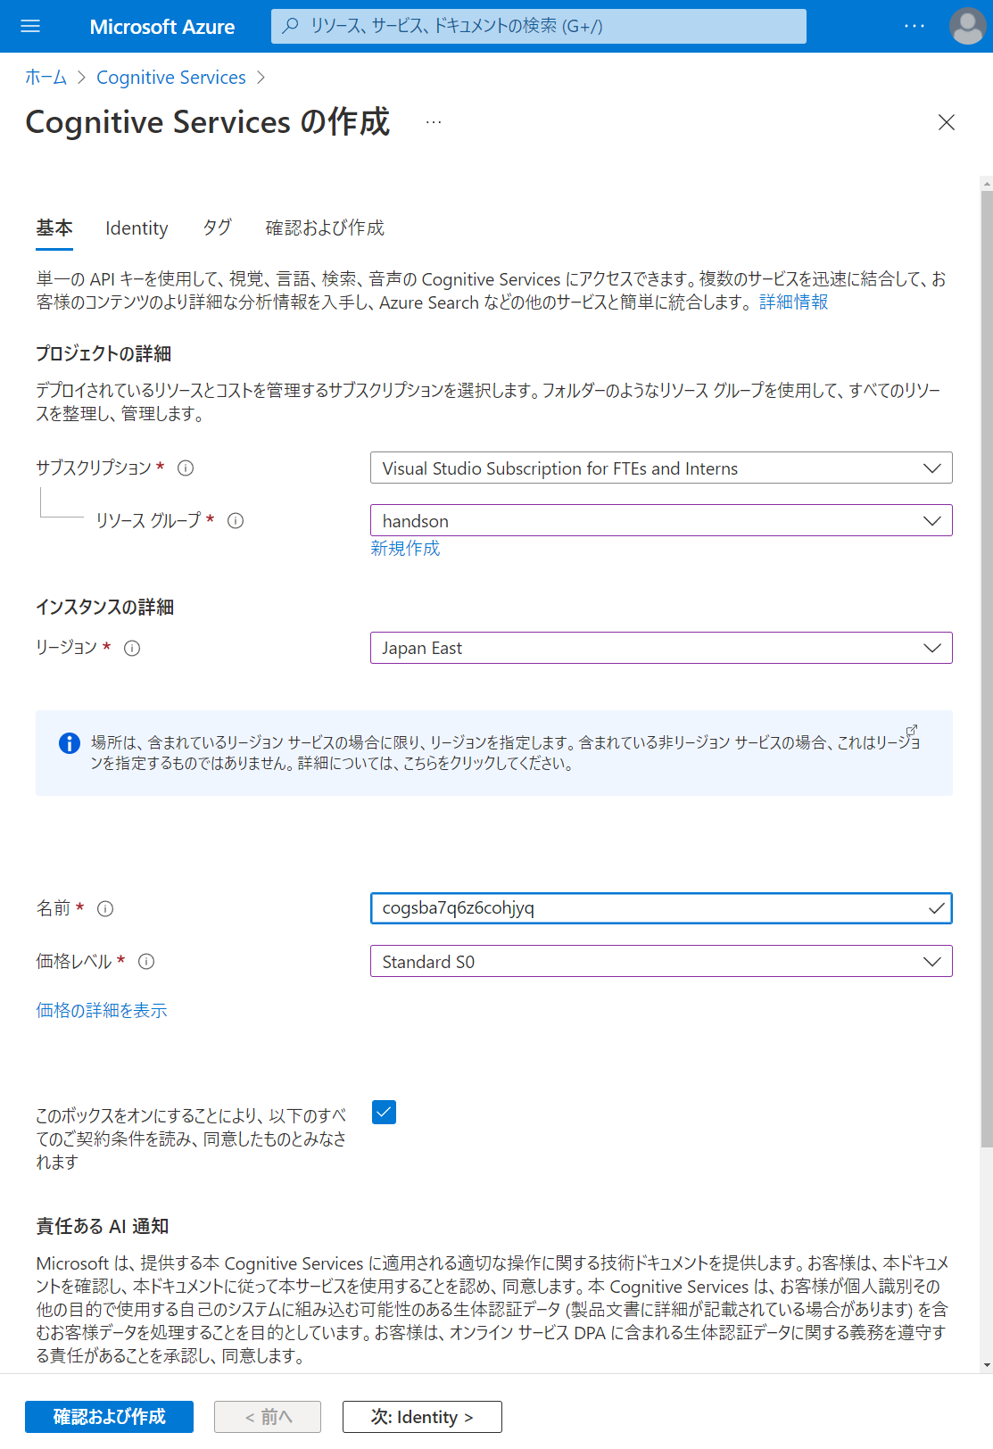

Slide 14
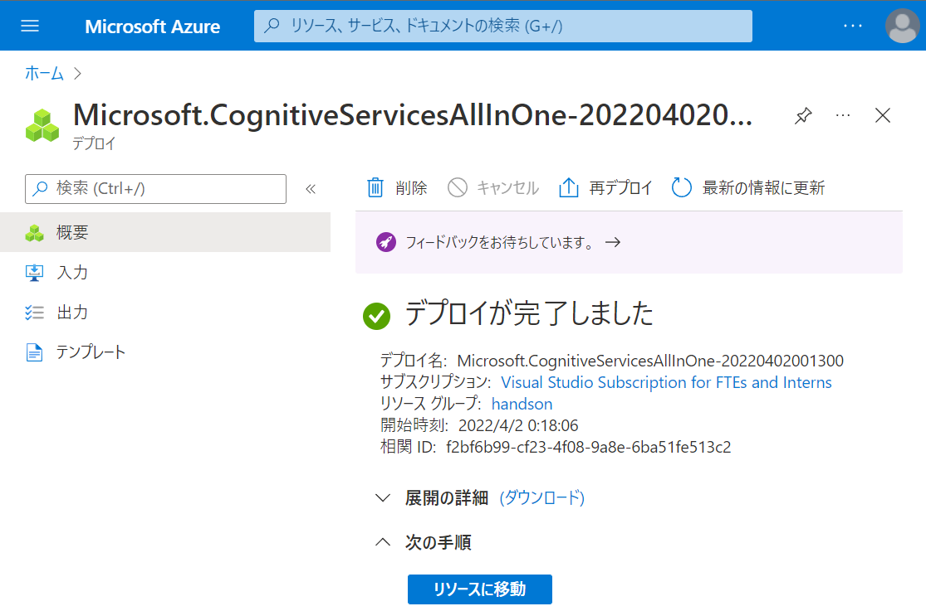

Slide 15
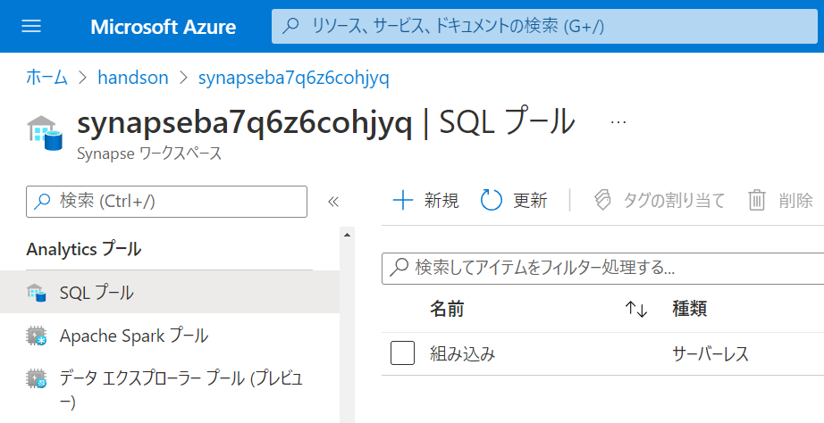

Slide 16
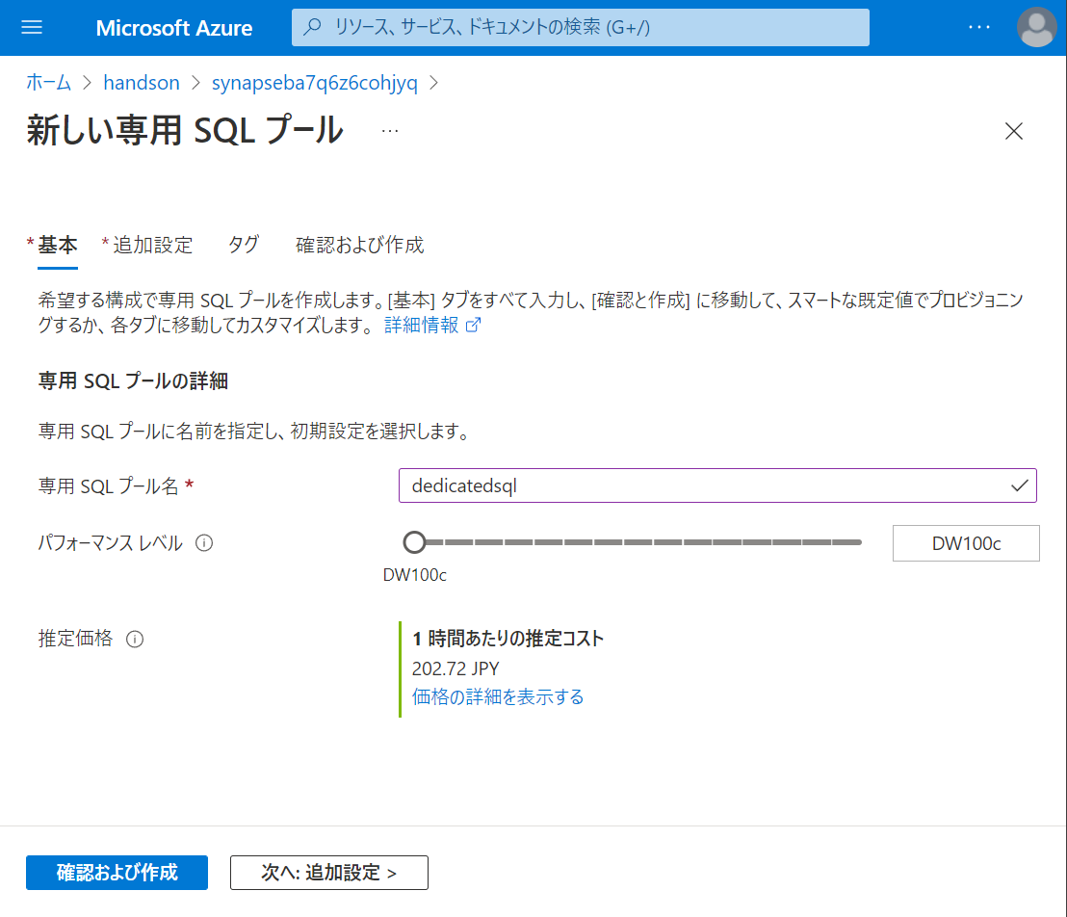

Slide 17
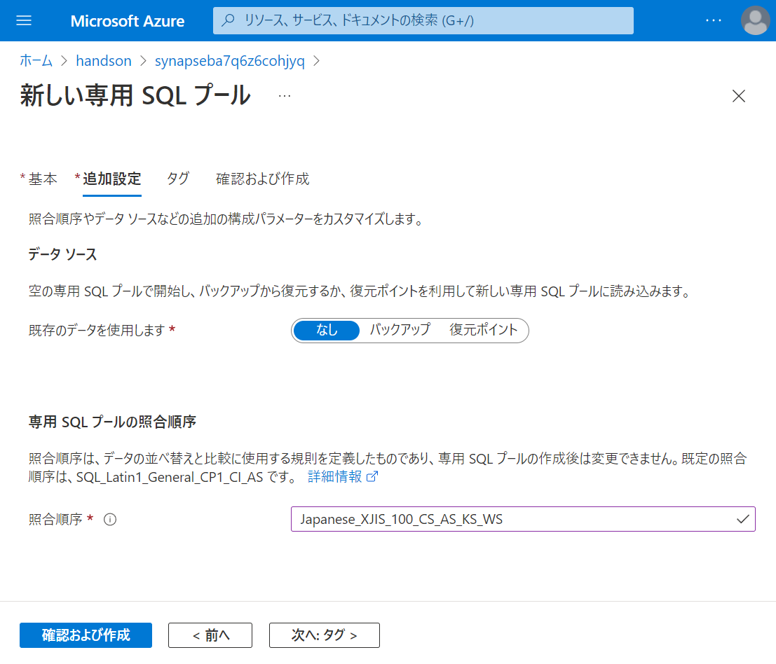

Slide 18
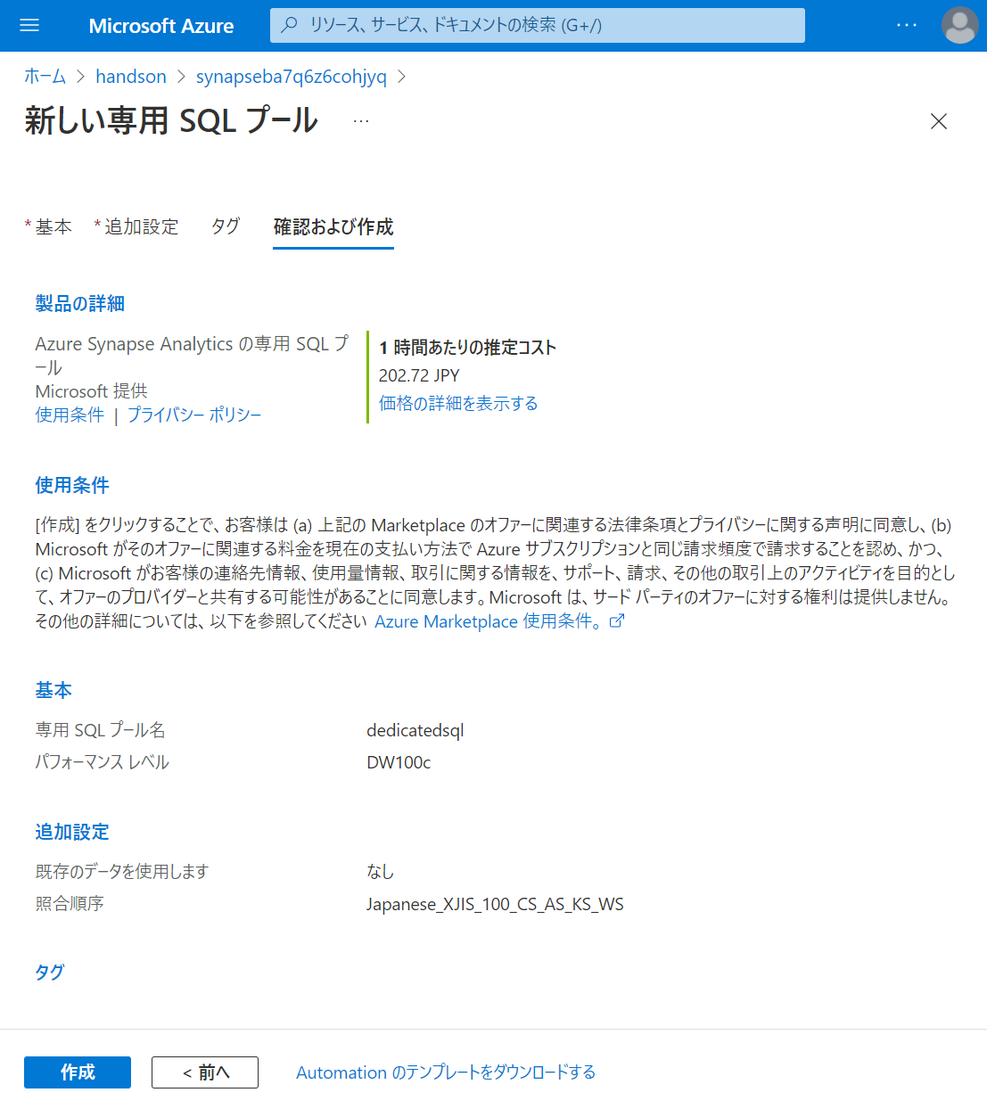

Slide 19
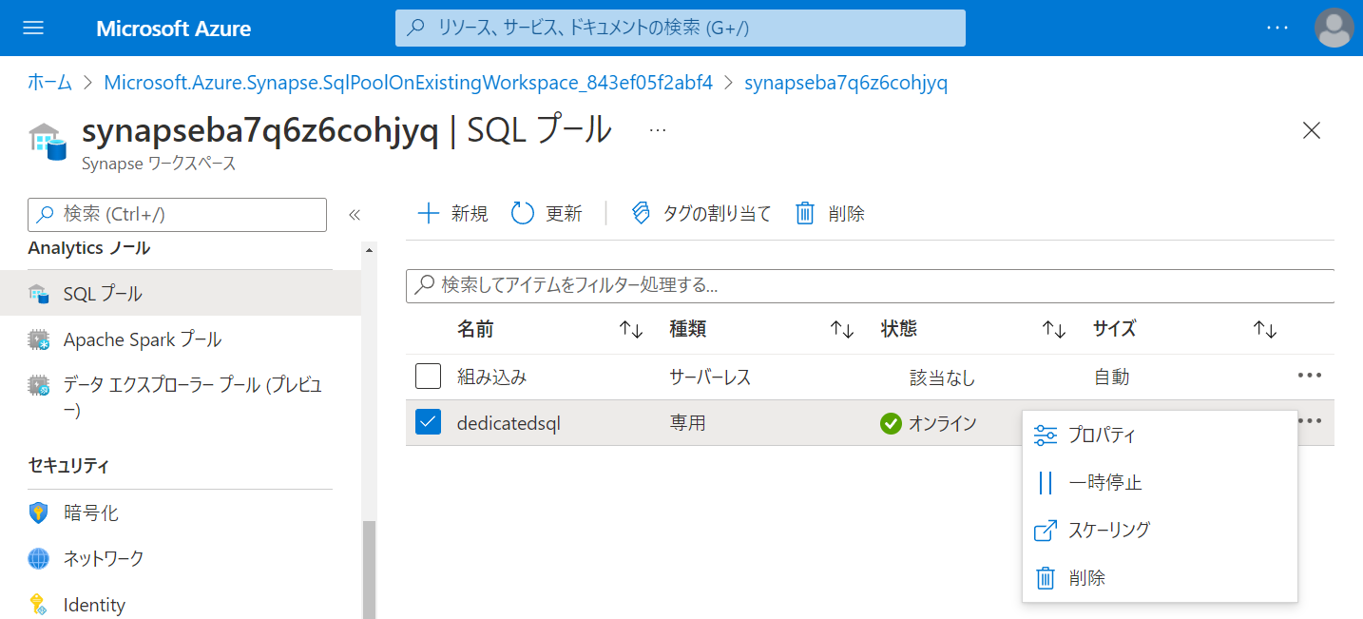

Slide 20
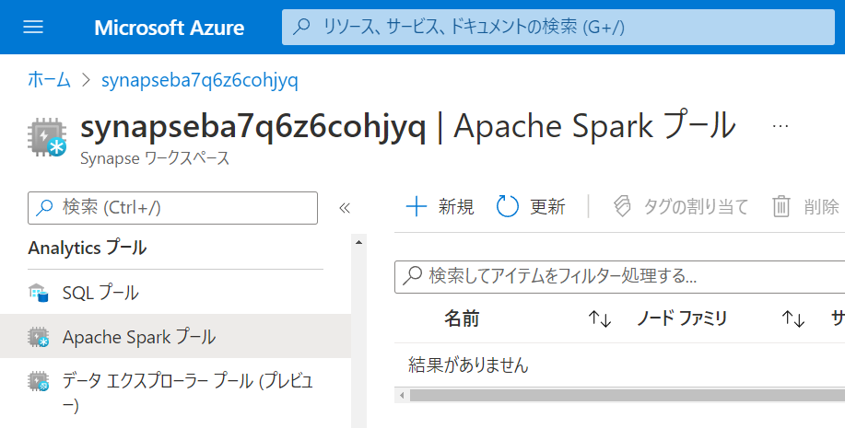

Slide 21
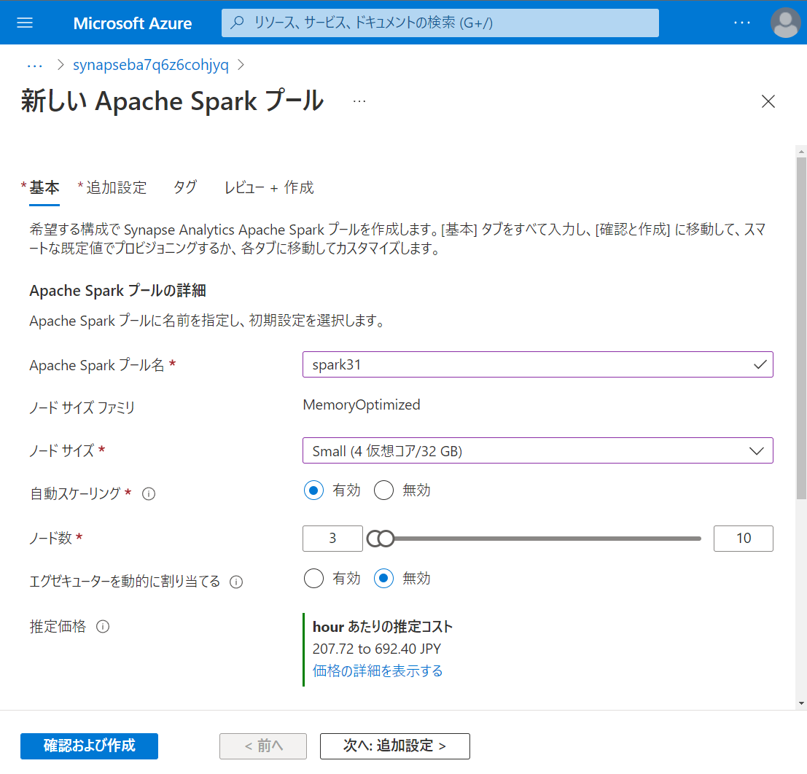

Slide 22
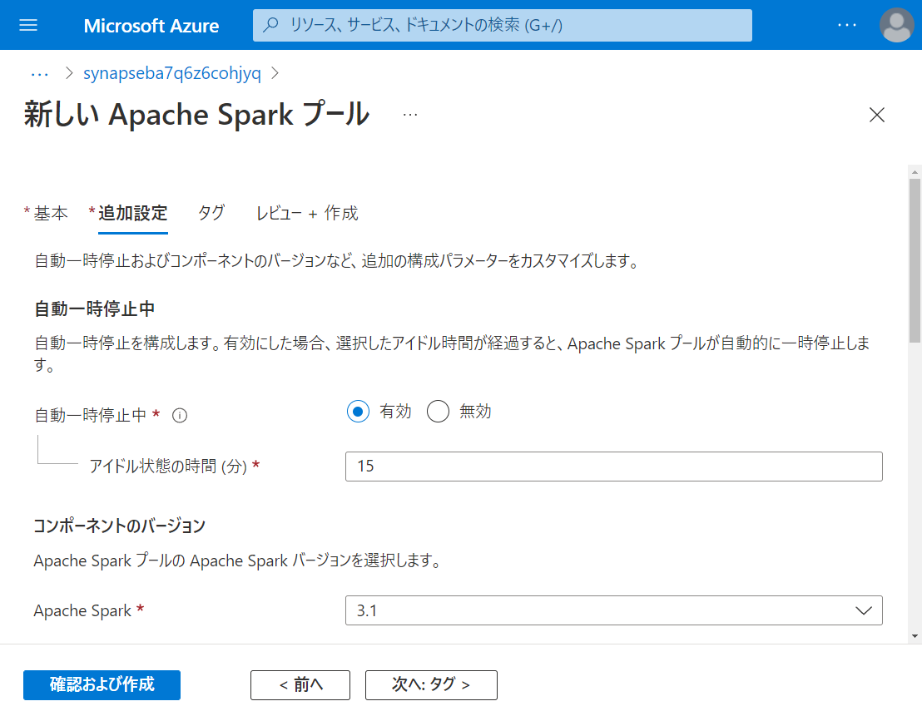

Slide 23
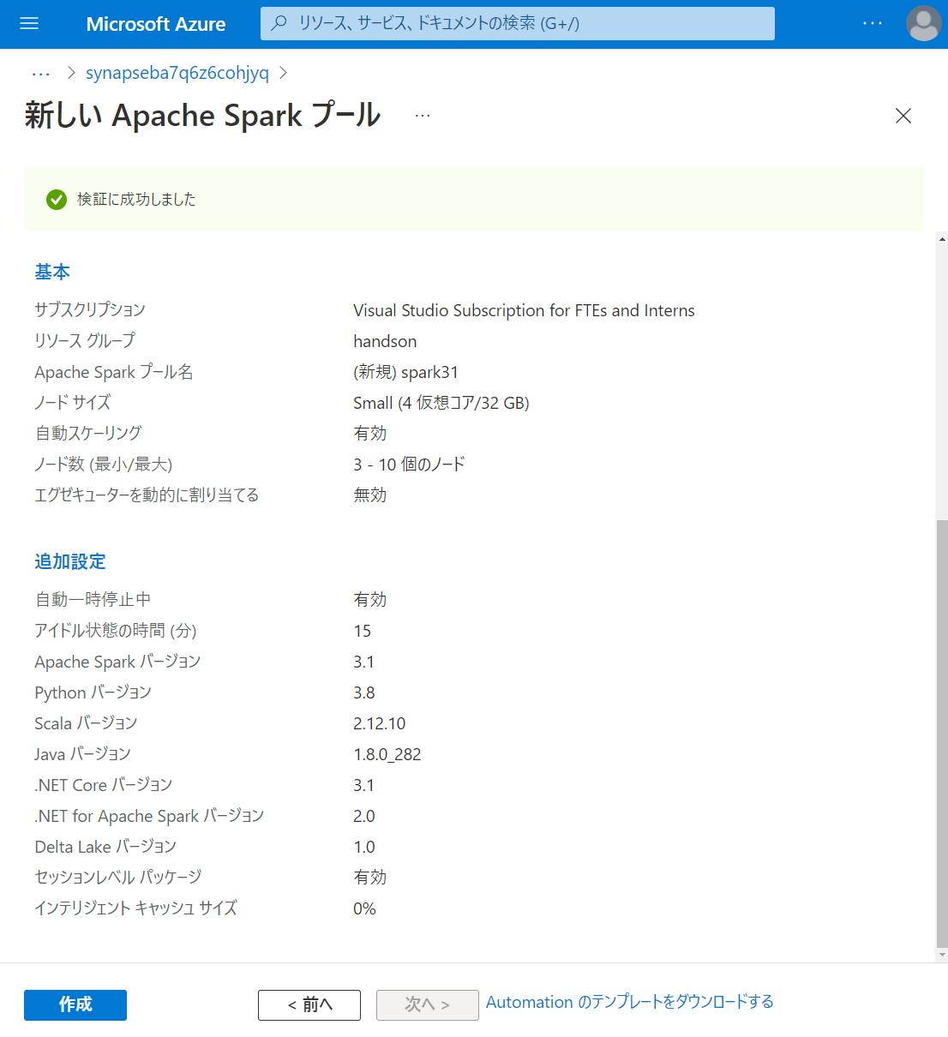

Slide 24
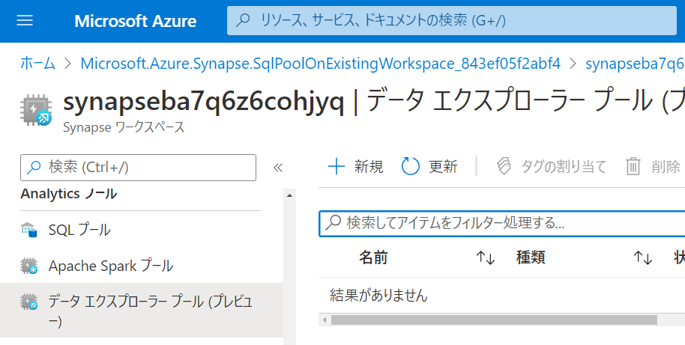

Slide 25
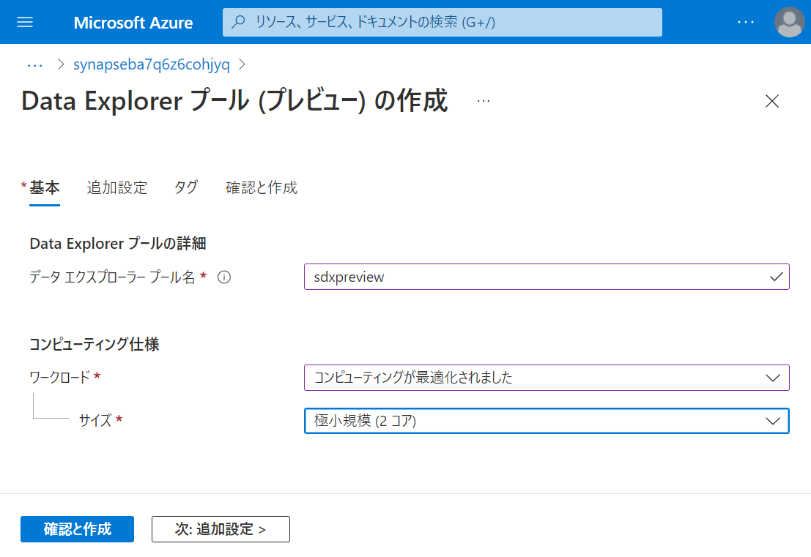

Slide 26
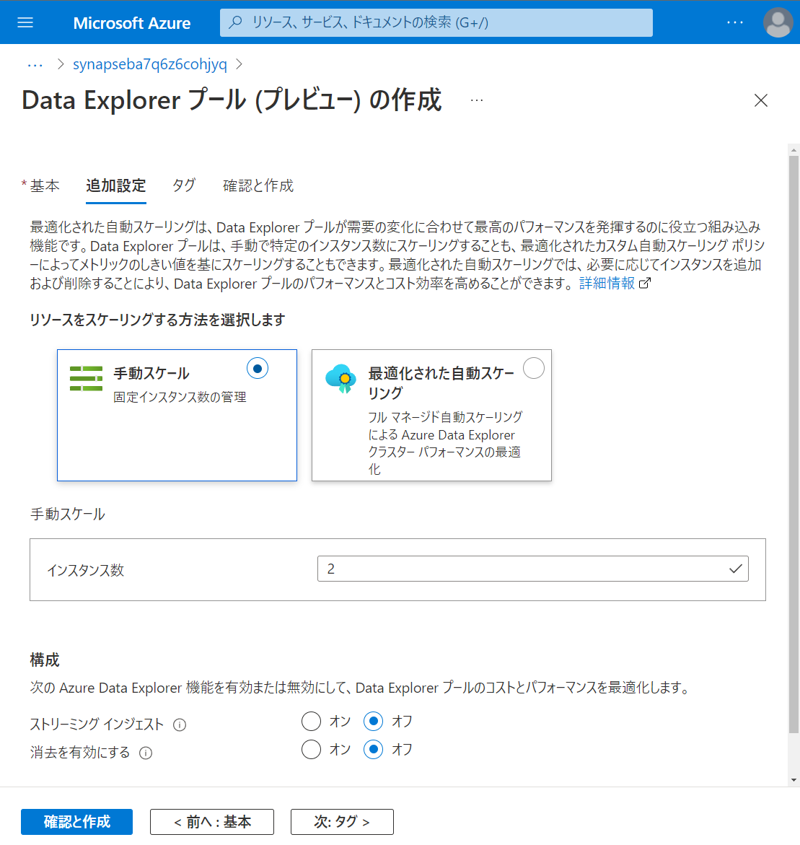

Slide 27
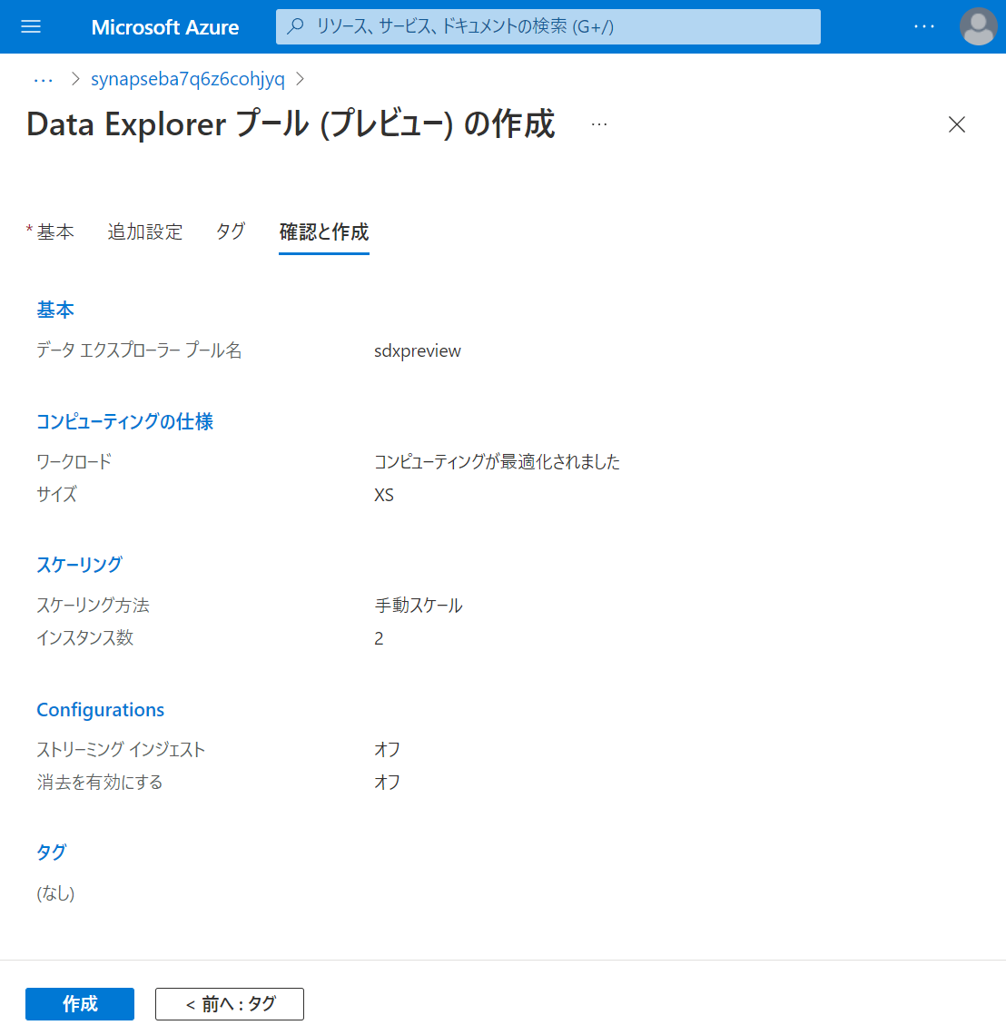

Slide 28
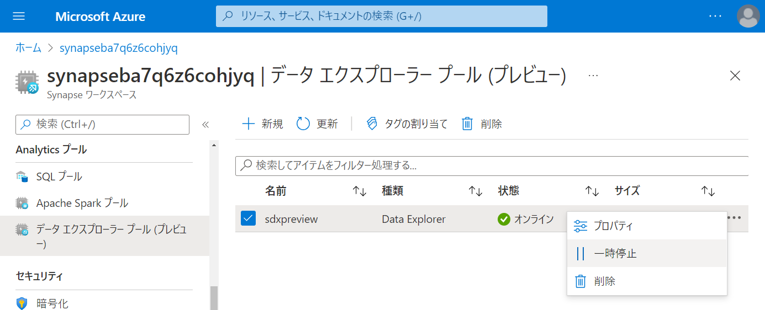

Slide 29
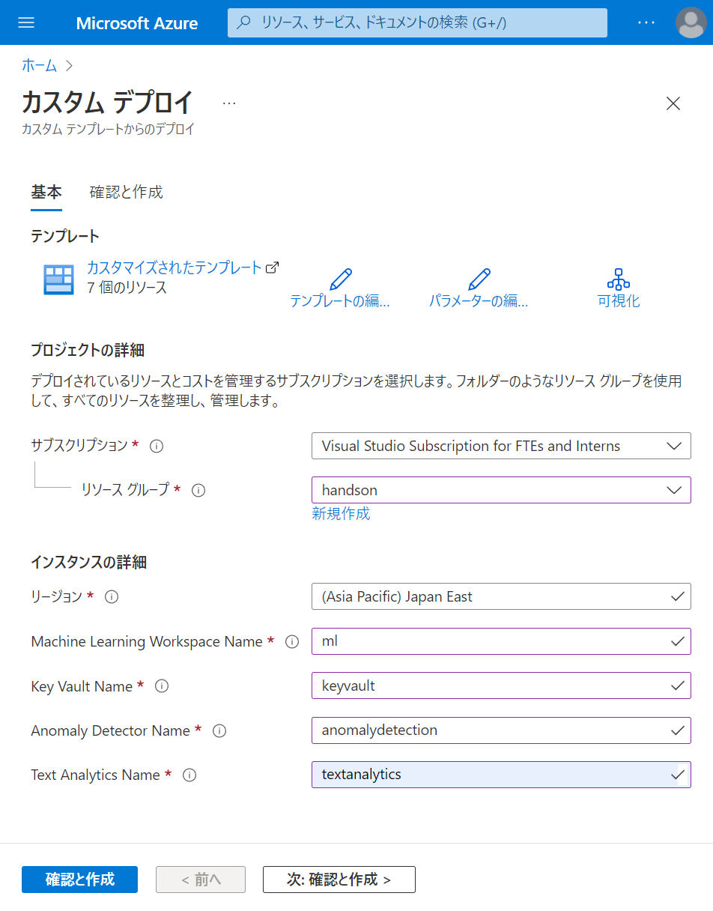

Slide 30
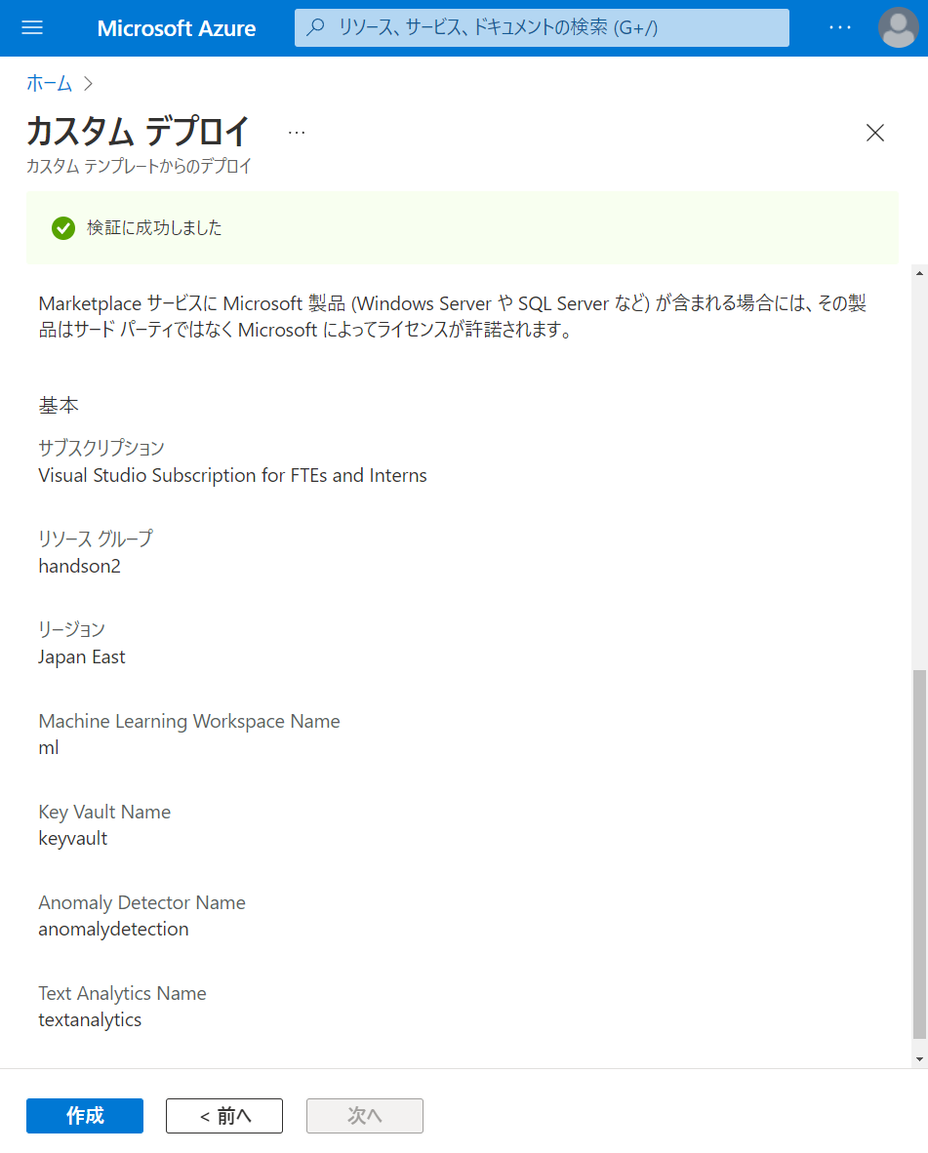

Slide 31
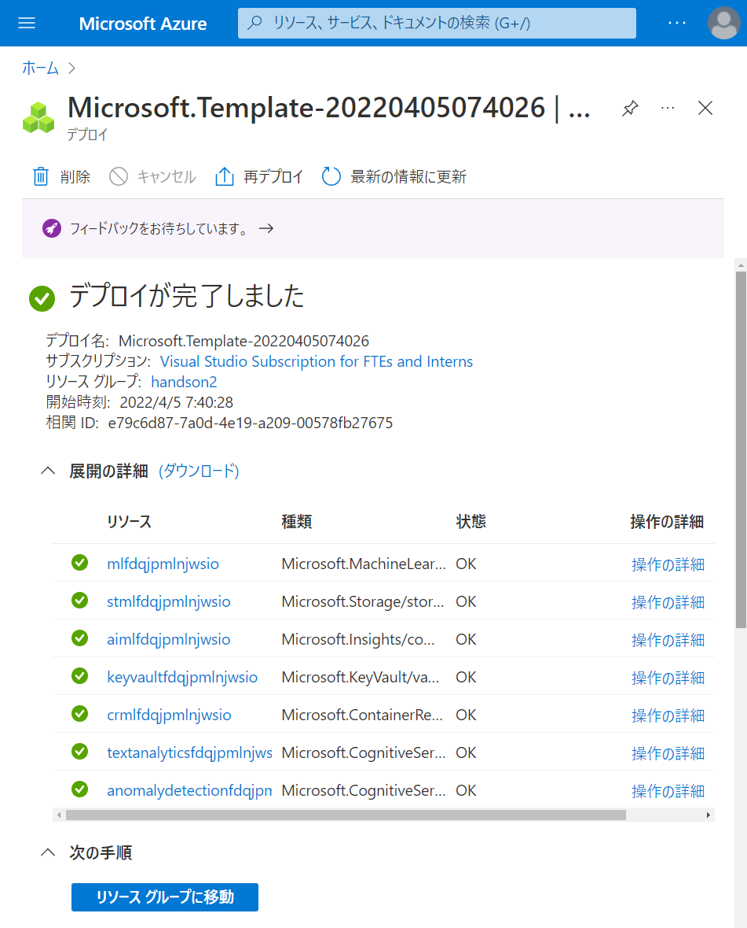

Slide 32
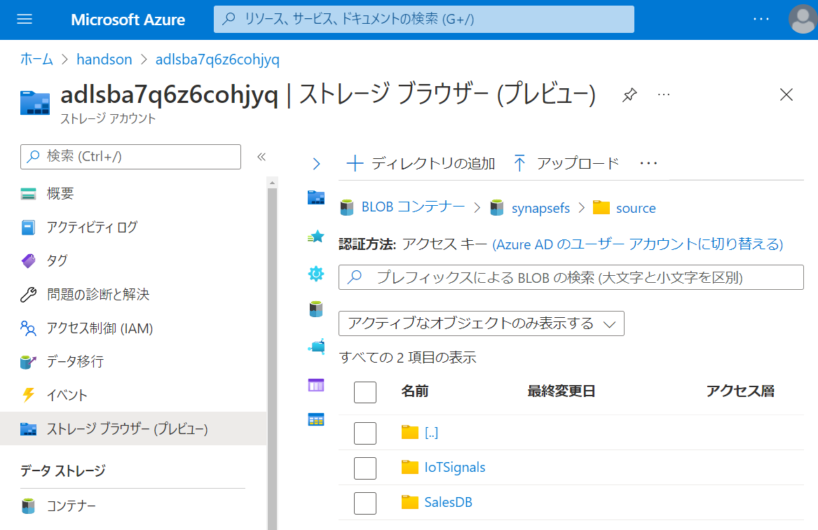

Slide 33
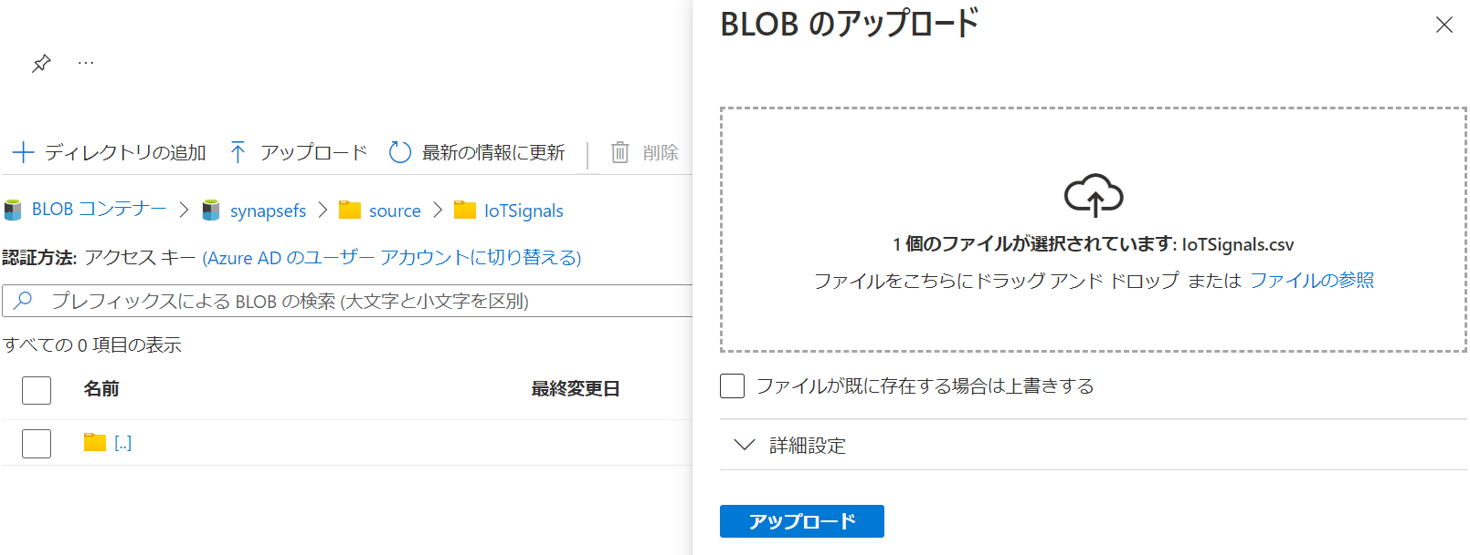

Slide 34
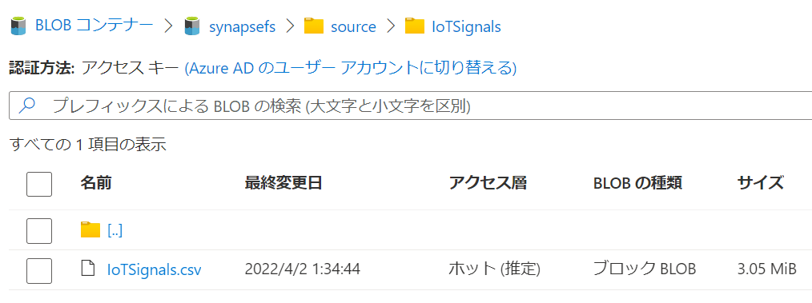

Slide 35
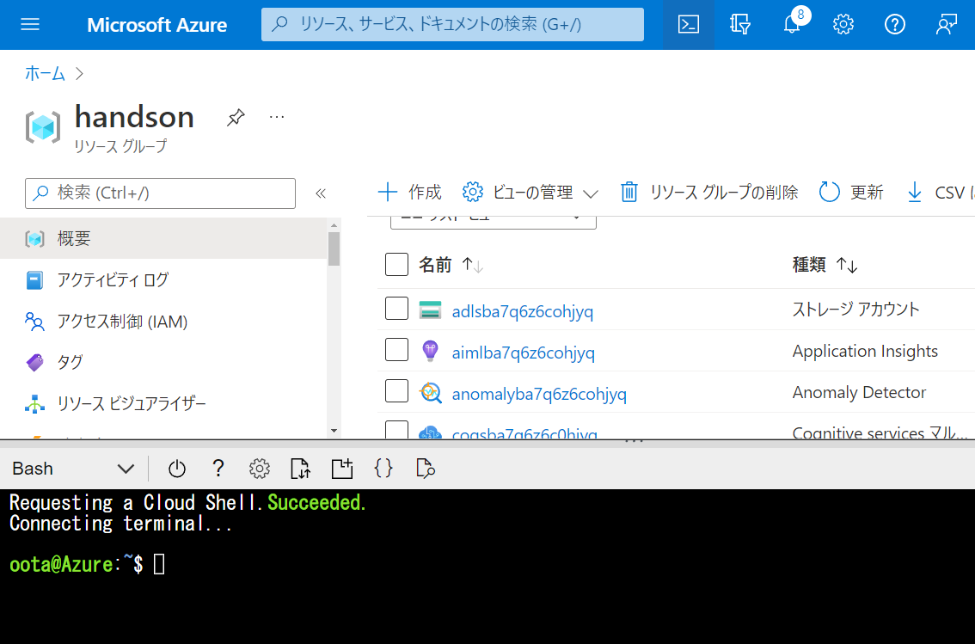

Slide 36
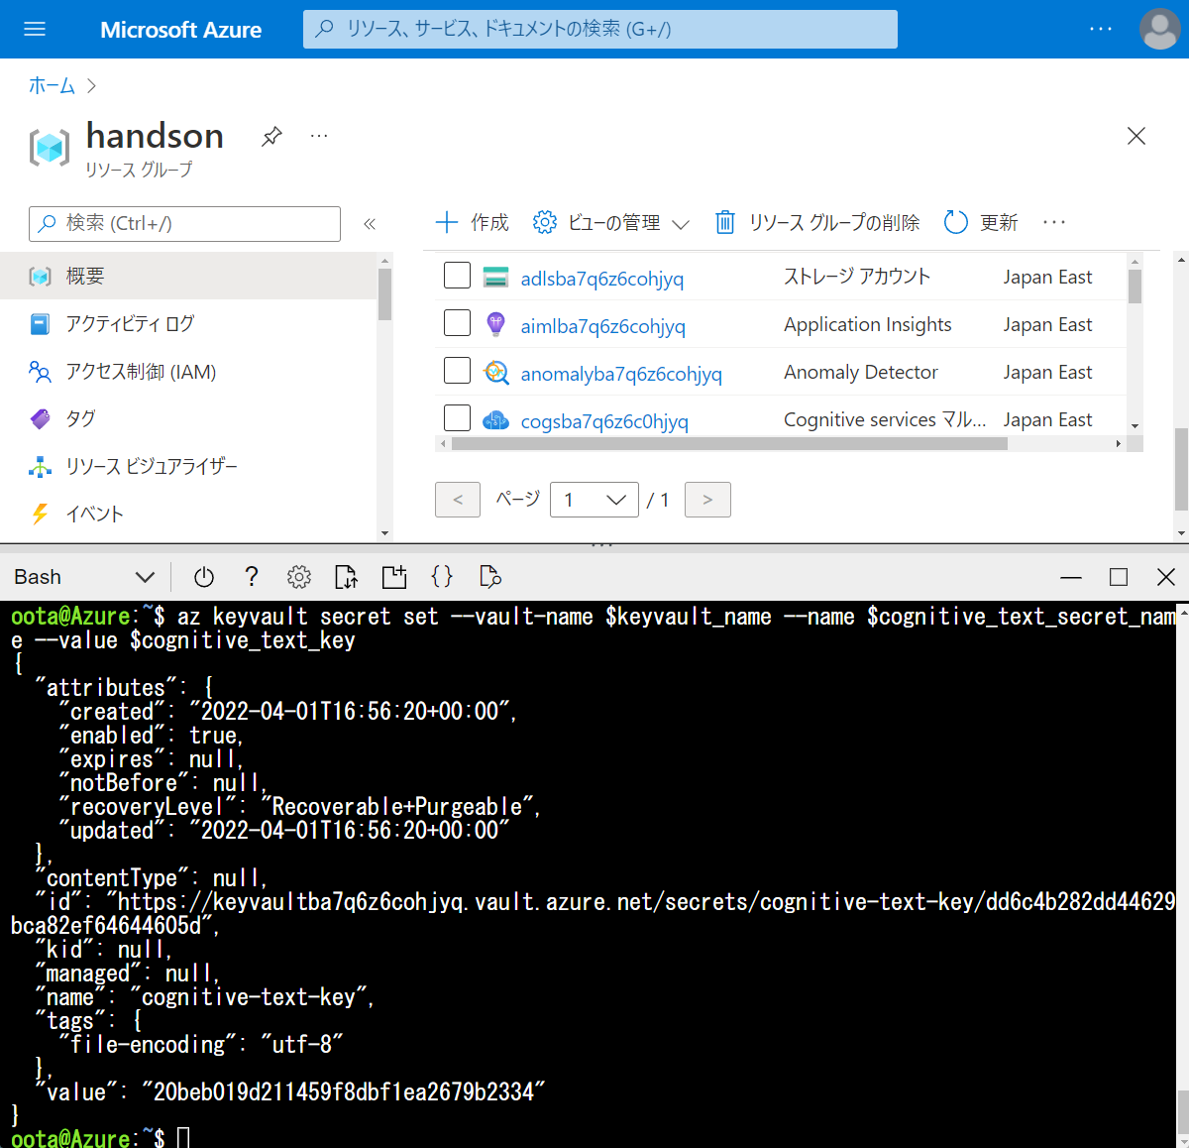

Slide 37
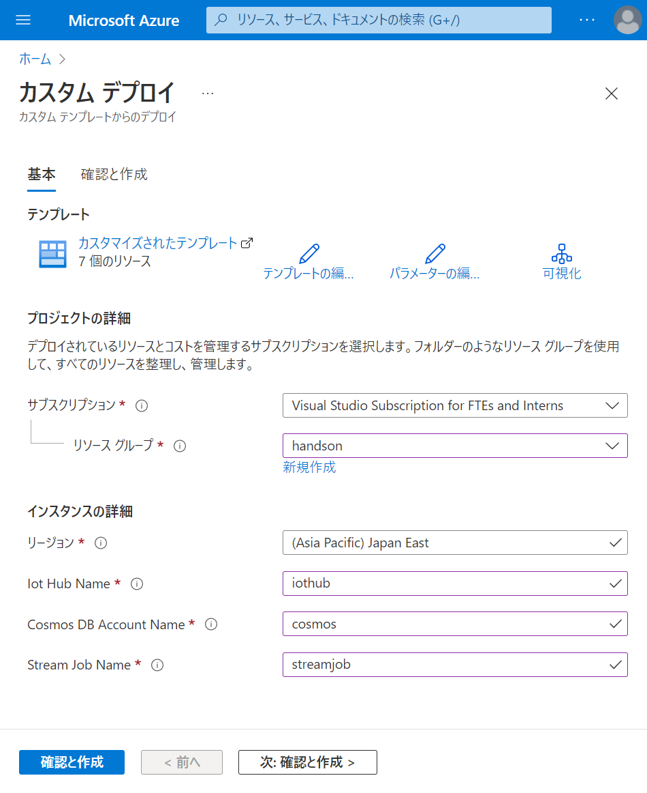

Slide 38
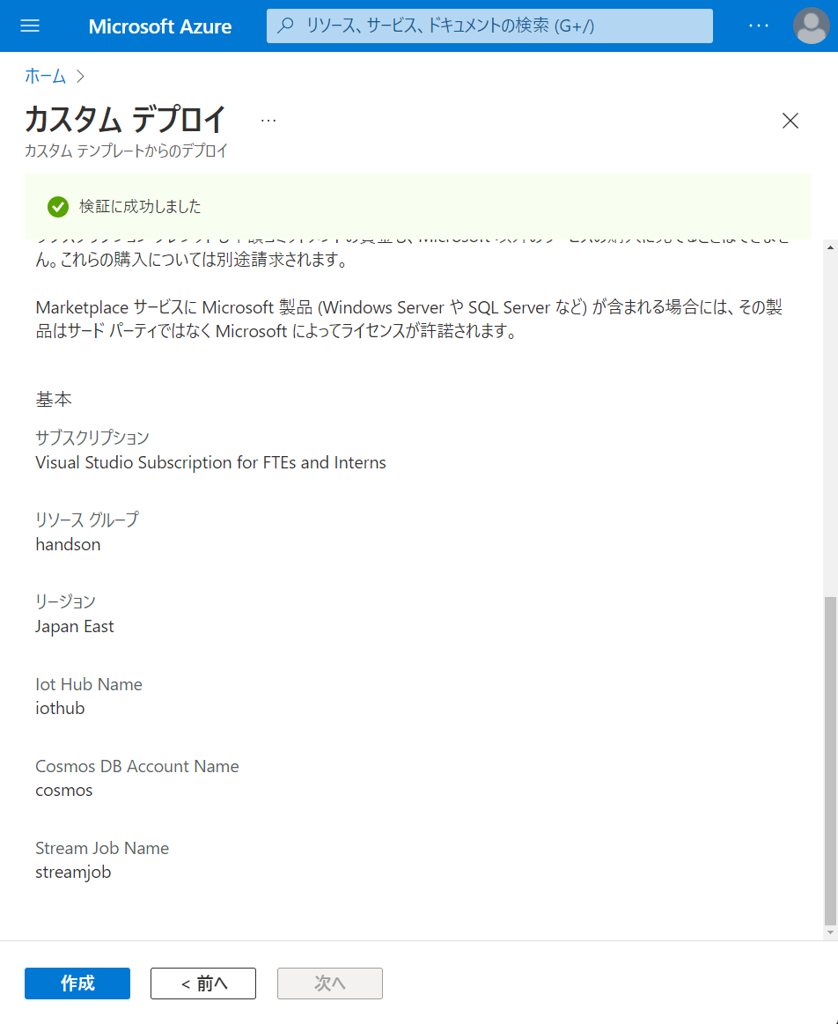

Slide 39
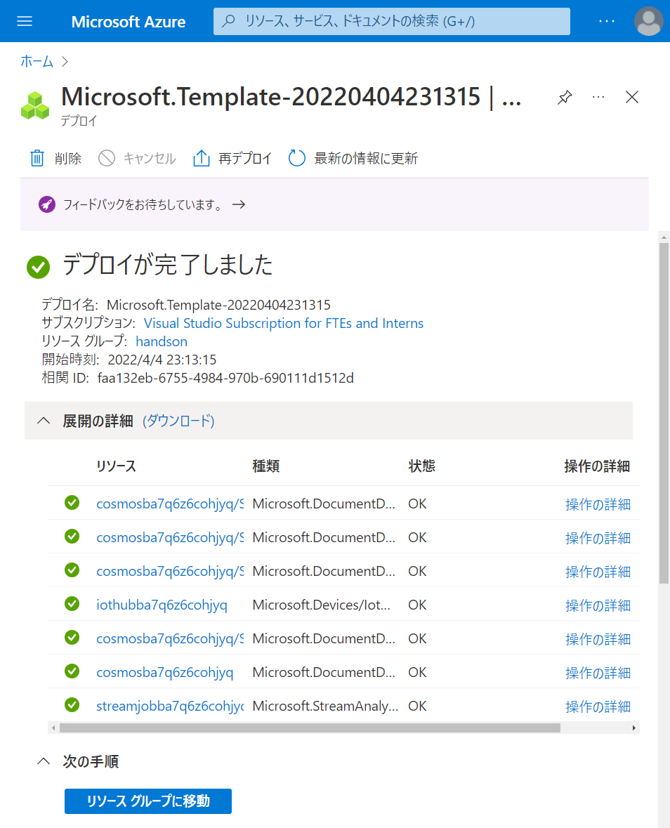

Slide 40
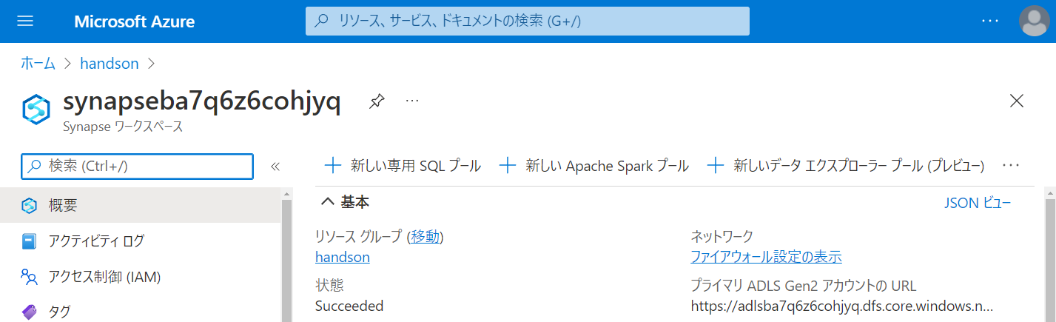

Slide 42
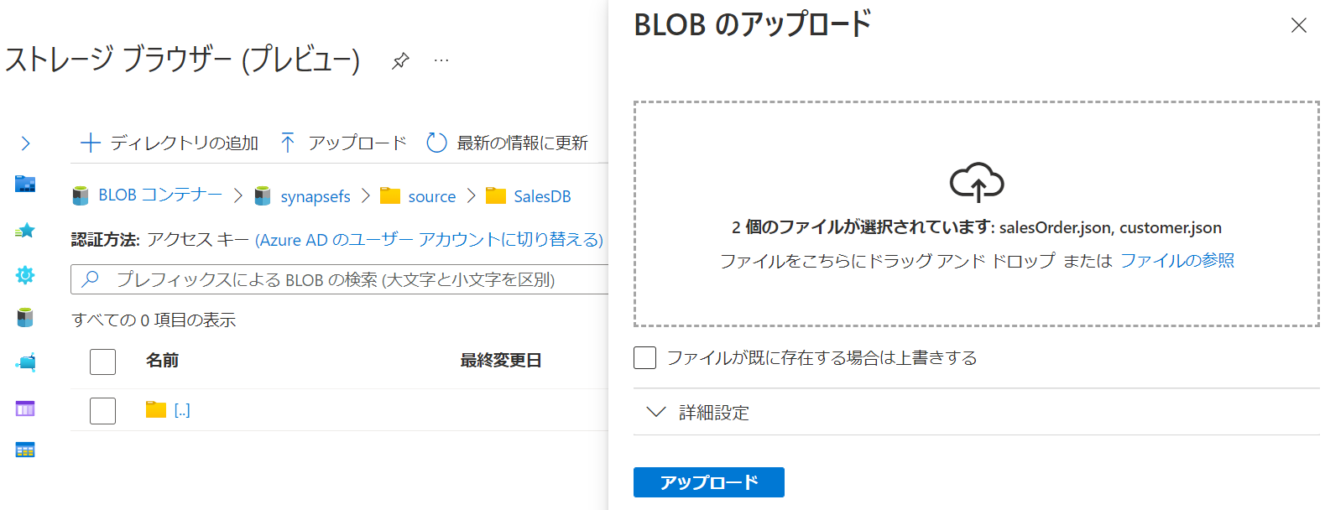

Slide 43
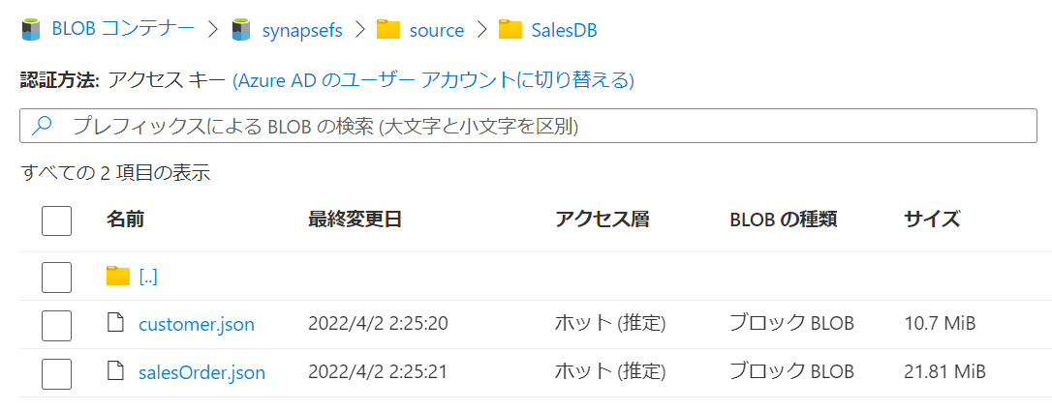

Slide 44
第5章：データの統合と可視化
Generate
Ingest
Store
Process
Enrich
Serve
Consume
On-Prems / Cloud
Realtime
Stream
Hot Path
IoT Hub
Batch
Functions
Power BI Premium
Dashboard
Event Hubs
Stream Analytics
Un/Semi -Structured
Cognitive Services
Analytics
SQL Database
Relational
Dedicated SQL
Data Explorer
Machine Learning
Cold Path
Dataflow
Cosmos DB
Data-driven Applications
Pipeline
NoSQL
Serverless Spark
Serverless SQL
HTAP with Synapse Link
Data Lake
Data Share
Shared Datasets
Discover & Govern
Azure Purview
Azure Active Directory
Azure Cost Management
Azure Key Vault
Azure Security Center
Platform
Azure Monitor
Azure DevOps
GitHub
Azure Policy

Slide 45
第6章：アドホックデータ探索とデータプレパレーション
Generate
Ingest
Store
Process
Enrich
Serve
Consume
On-Prems / Cloud
Realtime
Stream
Hot Path
IoT Hub
Batch
Functions
Power BI Premium
Dashboard
Event Hubs
Stream Analytics
Un/Semi -Structured
Cognitive Services
Analytics
SQL Database
Relational
Dedicated SQL
Data Explorer
Machine Learning
Cold Path
Dataflow
Cosmos DB
Data-driven Applications
Pipeline
NoSQL
Serverless Spark
Serverless SQL
HTAP with Synapse Link
Data Lake
Data Share
Shared Datasets
Discover & Govern
Azure Purview
Azure Active Directory
Azure Cost Management
Azure Key Vault
Azure Security Center
Platform
Azure Monitor
Azure DevOps
GitHub
Azure Policy

Slide 46
第7章：機械学習統合によるデータエンリッチメント
Generate
Ingest
Store
Process
Enrich
Serve
Consume
On-Prems / Cloud
Realtime
Stream
Hot Path
IoT Hub
Batch
Functions
Power BI Premium
Dashboard
Event Hubs
Stream Analytics
Un/Semi -Structured
Cognitive Services
Analytics
SQL Database
Relational
Dedicated SQL
Data Explorer
Machine Learning
Cold Path
Dataflow
Cosmos DB
Data-driven Applications
Pipeline
NoSQL
Serverless Spark
Serverless SQL
HTAP with Synapse Link
Data Lake
Data Share
Shared Datasets
Discover & Govern
Azure Purview
Azure Active Directory
Azure Cost Management
Azure Key Vault
Azure Security Center
Platform
Azure Monitor
Azure DevOps
GitHub
Azure Policy

Slide 47
第8章：リアルタイムデータ分析
Generate
Ingest
Store
Process
Enrich
Serve
Consume
On-Prems / Cloud
Realtime
Stream
Hot Path
IoT Hub
Batch
Functions
Power BI Premium
Dashboard
Event Hubs
Stream Analytics
Un/Semi -Structured
Cognitive Services
Analytics
SQL Database
Relational
Dedicated SQL
Data Explorer
Machine Learning
Cold Path
Dataflow
Cosmos DB
Data-driven Applications
Pipeline
NoSQL
Serverless Spark
Serverless SQL
HTAP with Synapse Link
Data Lake
Data Share
Shared Datasets
Discover & Govern
Azure Purview
Azure Active Directory
Azure Cost Management
Azure Key Vault
Azure Security Center
Platform
Azure Monitor
Azure DevOps
GitHub
Azure Policy

Slide 48
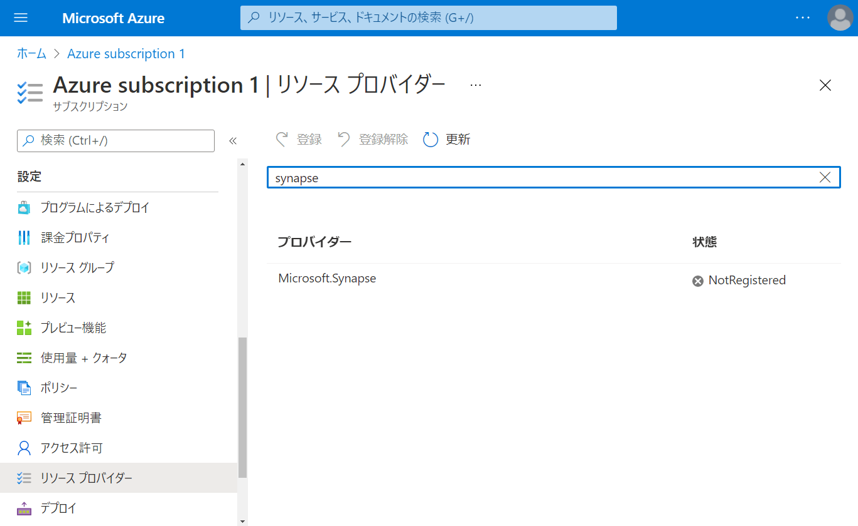

Slide 49
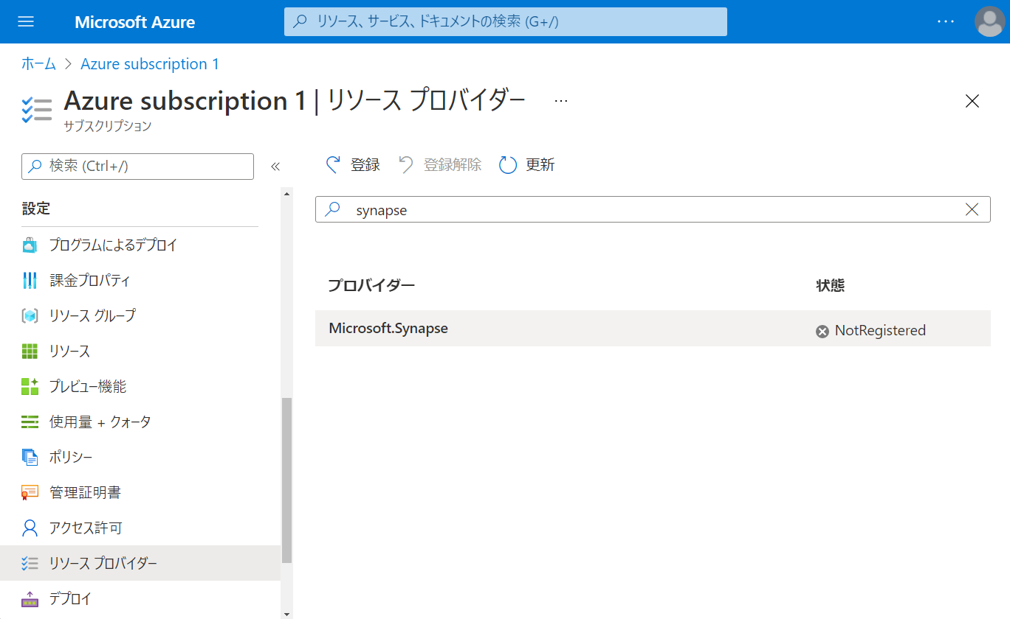

Slide 50
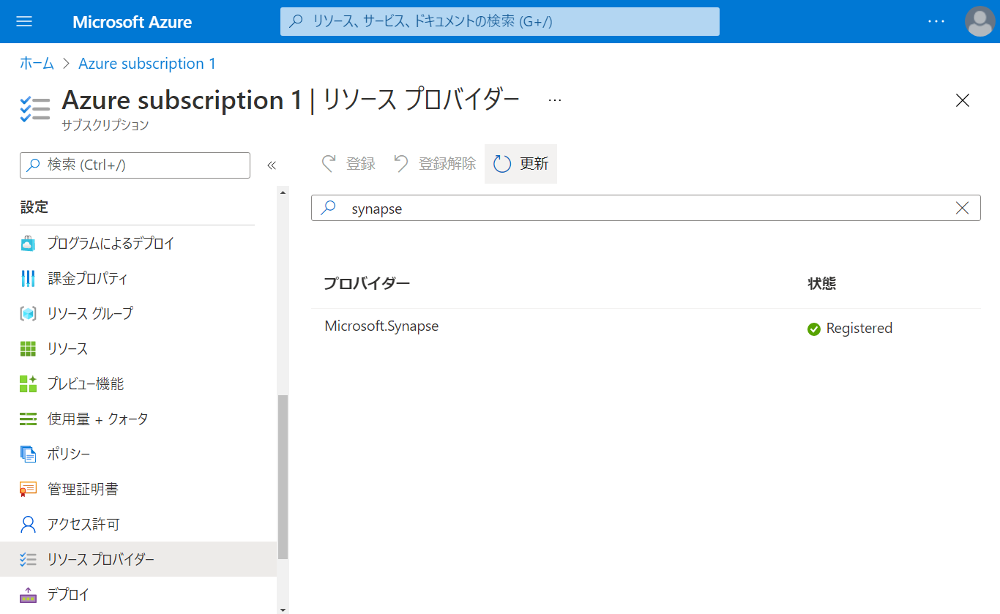

Slide 51
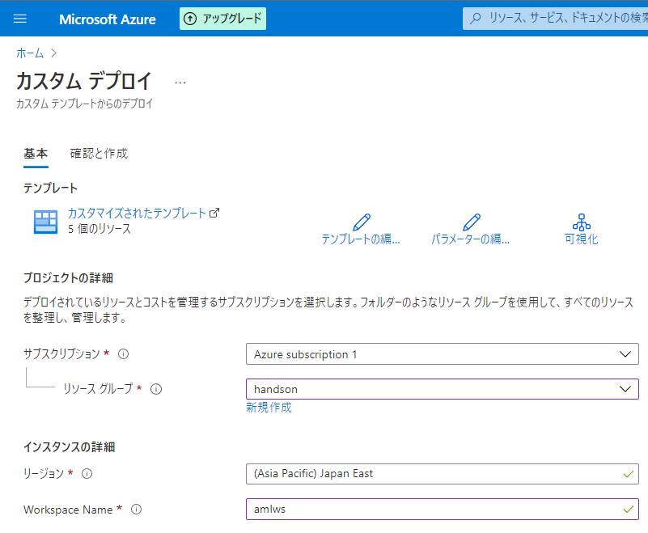

Slide 52
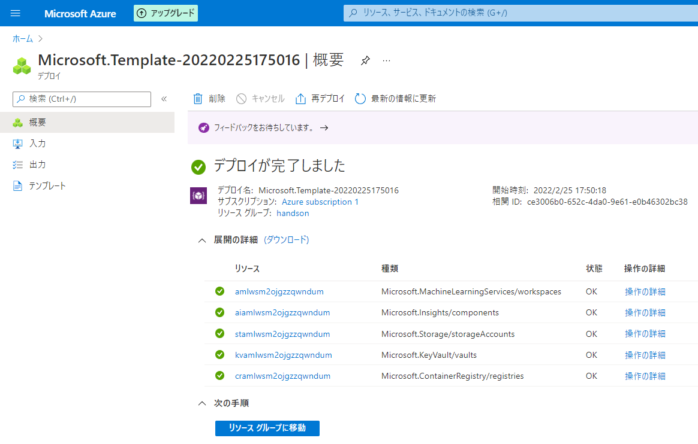

Slide 53
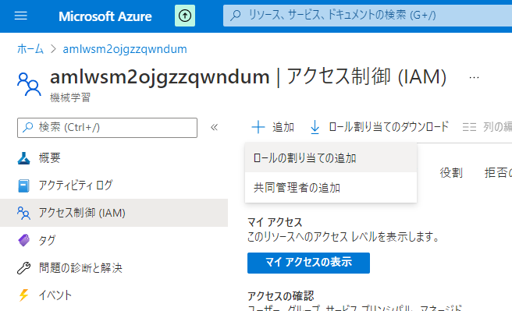

Slide 54
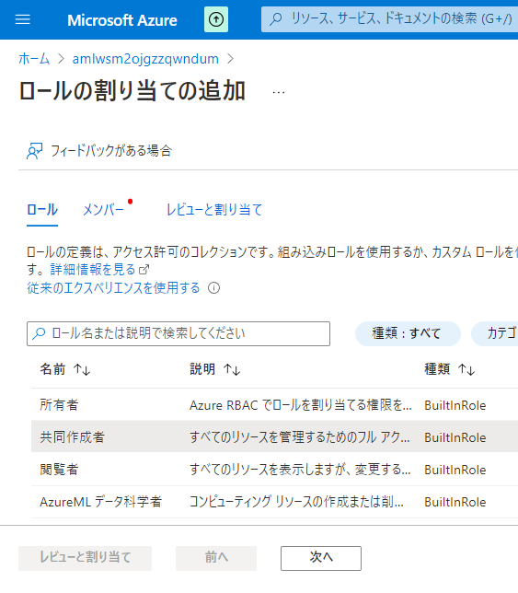

Slide 55
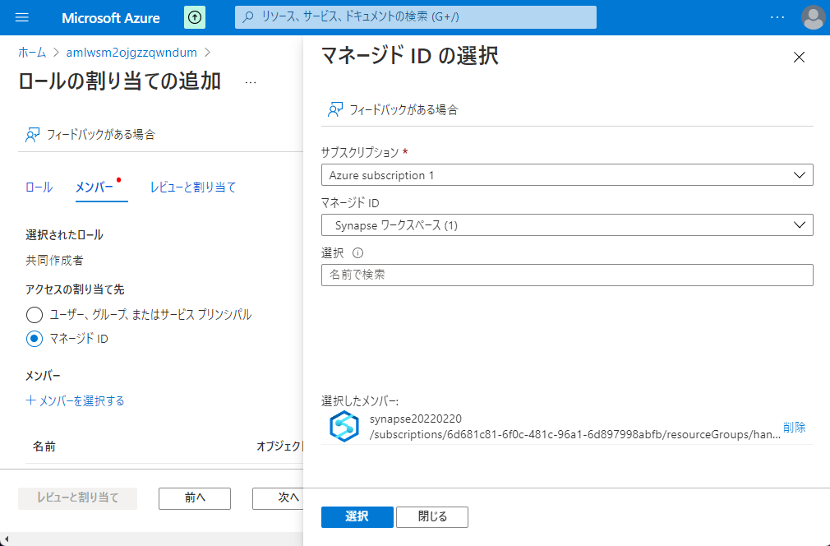

Slide 56
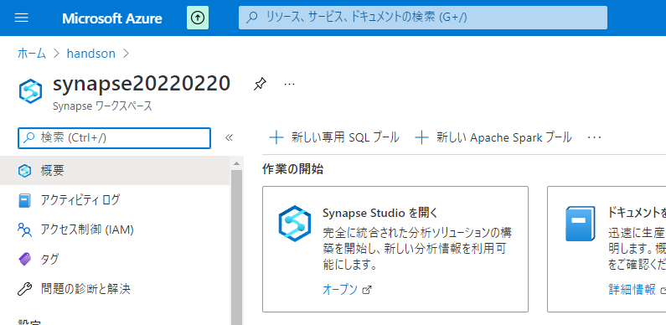

Slide 57


Slide 58


Slide 59


Slide 60


Slide 61


Slide 62

不要

Slide 63

不要

Slide 64

不要

Slide 65

不要

Slide 66


Slide 67


Slide 69


Slide 70



Slide 71


Slide 73


Slide 75


Slide 76


Slide 77


Slide 78


Slide 79


Slide 80


Slide 81


Slide 82


Slide 83


Slide 84


Slide 85


Slide 86


Slide 87


Slide 88


Slide 89


Slide 90


Slide 92


Slide 93


Slide 94


Slide 95


Slide 96


Slide 97


Slide 99


Slide 100


Slide 101


Slide 102


Slide 103


Slide 104

右クリック

Slide 105


Slide 107


Slide 108


Slide 109


Slide 111


Slide 112


Slide 113


Slide 114


Slide 115


Slide 116


Slide 117


Slide 118


Slide 119


Slide 120


Slide 121

ドラッグ&ドロップ

Slide 122

ドラッグ&ドロップ

Slide 123


Slide 124


Slide 125

5-2-2-1

Slide 126

5-2-2-1

Slide 127

5-2-2-2

Slide 128

5-2-2-2

Slide 129

5-2-2-2
右クリック

Slide 130

5-2-2-2

Slide 131

5-3-1-1

Slide 132

5-3-1-1

Slide 133

5-3-1-2

Slide 134

5-3-1-2

Slide 135

5-3-1-2

Slide 136

5-3-1-2

Slide 137

5-3-1-2

Slide 138

5-3-1-2

Slide 139

5-3-1-2

Slide 140

5-3-1-2

Slide 141

5-3-1-2

Slide 142

5-3-1-2

Slide 143

5-3-1-2

Slide 144

5-3-1-2
Column Name | Expression
PickUpDate | toDate(tpep_pickup_datetime,'yyyy-MM-dd')
PickUpLocationID | toInteger(PULocationID)
PassengerCount | toInteger(passenger_count)
DistanceTravelled | toDecimal(trip_distance)
TipAmount | toDecimal(tip_amount)
FareAmount | toDecimal(fare_amount)
TotalAmount | toDecimal(total_amount)

Slide 145

5-3-1-2

Slide 146

5-3-1-2

Slide 147

5-3-1-2
- Join Settings > Output stream name: JoinPickUpLocation - Join Settings > Left stream: TransformColumns - Join Settings > Right stream: TaxiLocationLookup - Join Settings > Join type: Inner - Join Settings > Join conditions > Left: PickUpLocationID - Join Settings > Join conditions > Right: LocationID

Slide 148

5-3-1-2

Slide 149

5-3-1-2
PickUpDate
PaymentType
Borough
Zone

Slide 150

5-3-1-2
Column Name | Expression
TotalTripCount | count()
TotalPassengerCount | sum(PassengerCount)
TotalDistanceTravelled | sum(DistanceTravelled)
TotalTipAmount | sum(TipAmount)
TotalFareAmount | sum(FareAmount)
TotalTripAmount | sum(TotalAmount)

Slide 151

5-3-1-2

Slide 152

5-3-1-2
Borough to PickUpBorough
Zone to PickUpZone

Slide 153

5-3-1-2

Slide 154

5-3-1-2

Slide 155

5-3-1-2

Slide 156

5-3-1-2

Slide 157

5-3-2-1
ドラッグ&ドロップ

Slide 158

5-3-2-2

Slide 159


5-3-2-3

Slide 160

5-3-2-4

Slide 161

5-3-2-4

Slide 162

5-3-2-5

Slide 163

5-3-2-6

Slide 164

5-3-2-6
右クリック

Slide 165

5-3-2-6

Slide 166


Slide 167


Slide 168


Slide 169


Slide 170


Slide 171


Slide 172


Slide 173


Slide 174


Slide 175



Power BI 環境
Synapse Studio からリンクする際にはワークスペースが必要
Power BI Service にログインしてもらいワークスペースを作成してもらう
ライセンスない場合は「無料で試す」から手続きしてもらう

Slide 176


Slide 177


Slide 178


Slide 179




Slide 180


Slide 181





Slide 182


Slide 183


ゲストアカウントをSynapse管理者として登録する方法
IAM追加
StudioからSynapse管理者として登録

Slide 185


Slide 186


Slide 187


Slide 188


Slide 189


Slide 190


Slide 191


Slide 192


Slide 193


Slide 194


Slide 195


Slide 196


Slide 197


Slide 198

コメントアウトを削除

Slide 199


Slide 200

コードをペースト

Slide 201


Slide 202


Slide 203


Slide 204


Slide 205


Slide 206


Slide 207


Slide 208


Slide 209


Slide 210


Slide 211


Slide 212


Slide 213


Slide 214


Slide 215


Slide 216


Slide 217


Slide 218


Slide 219


Slide 220


Slide 221


Slide 222



Slide 223



Slide 224



Slide 225


Slide 226


Slide 227


Slide 228


Slide 229


Slide 230


Slide 231



Slide 232



Slide 233


Slide 234


Slide 235


Slide 236


Slide 238


Slide 241


Slide 242


Slide 243


Slide 244


Slide 245


Slide 246


Slide 247


Slide 248


Slide 249


Slide 250


Slide 251


Slide 252


Slide 253


Slide 254
第8章：リアルタイムデータ分析
Generate
Ingest
Store
Process
Enrich
Serve
Consume
On-Prems / Cloud
Realtime
Stream
Hot Path
IoT Hub
Batch
Functions
Power BI Premium
Dashboard
Event Hubs
Stream Analytics
Un/Semi -Structured
Cognitive Services
Analytics
SQL Database
Relational
Dedicated SQL
Data Explorer
Machine Learning
Cold Path
Dataflow
Cosmos DB
Data-driven Applications
Pipeline
NoSQL
Serverless Spark
Serverless SQL
HTAP with Synapse Link
Data Lake
Data Share
Shared Datasets
Discover & Govern
Azure Purview
Azure Active Directory
Azure Cost Management
Azure Key Vault
Azure Security Center
Platform
Azure Monitor
Azure DevOps
GitHub
Azure Policy

Slide 255


Slide 256


Slide 257


Slide 258


Slide 259


Slide 260


Slide 261


Slide 262


Slide 263


Slide 264


Slide 265


Slide 266


Slide 267


Slide 268


Slide 269


Slide 270


Slide 271



Slide 272


Slide 274


Slide 275


Slide 276


Slide 277


Slide 278


Slide 279


Slide 280


Slide 281


Slide 282


Slide 283


Slide 284


Slide 285


Slide 286


Slide 287


Slide 288


Slide 289


Slide 290


Slide 291


Slide 292


Slide 293


Slide 294


Slide 295


Slide 296


Slide 297


Slide 298


Slide 299


Slide 300


Slide 301


Slide 302


Slide 303


Slide 304


Slide 305


Slide 306


Slide 307


Slide 308


Slide 309


Slide 310


Slide 311


Slide 312


Slide 313


Slide 314


Slide 315


Slide 316


Slide 317


Slide 318


Slide 319


Slide 320


Slide 321


Slide 322


Slide 323


Slide 324


Slide 325


Slide 326


Slide 327


Slide 328


Slide 329


Slide 330


Slide 331


Slide 332


Slide 333


Slide 334


Slide 335


Slide 336


Slide 337


Slide 338


Slide 339


Slide 340


Slide 341


Slide 342


Slide 343


Slide 344



Slide 345


Slide 346


Slide 347


Slide 348


Slide 349


Slide 350


Slide 351


Slide 352


Slide 353


Slide 354


Slide 355
レポートファイルを保存
この時の名前が PBIレポートとデータセットの名前になる

Slide 356


Slide 357


Slide 358


Slide 359


Slide 360


Slide 361


Slide 362

Azure SQL Database with DirectQuery - Power BI | Microsoft Docs

Slide 363


Slide 364


Slide 365


Slide 366


Slide 367


Slide 368


Slide 369


Slide 370


